Slide 1


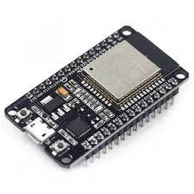

Slide 2


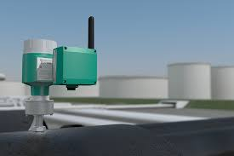
Entrenamiento
Transferencia
Dispositivo de Laboratorio
Red Neuronal
Dispositivos de Campo

Slide 3

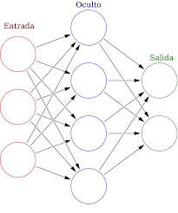


Slide 4
Medio de Transferencia
Toma de Muestras
Exportar Modelo
Importar Modelo
Toma de Muestra
Entrenamiento de Red Neuronal
Pruebas a la Red Neuronal
Predicción de Adulterantes
Procesamiento de Muestra
Dispositivo de Laboratorio
Dispositivo de Campo

Slide 5
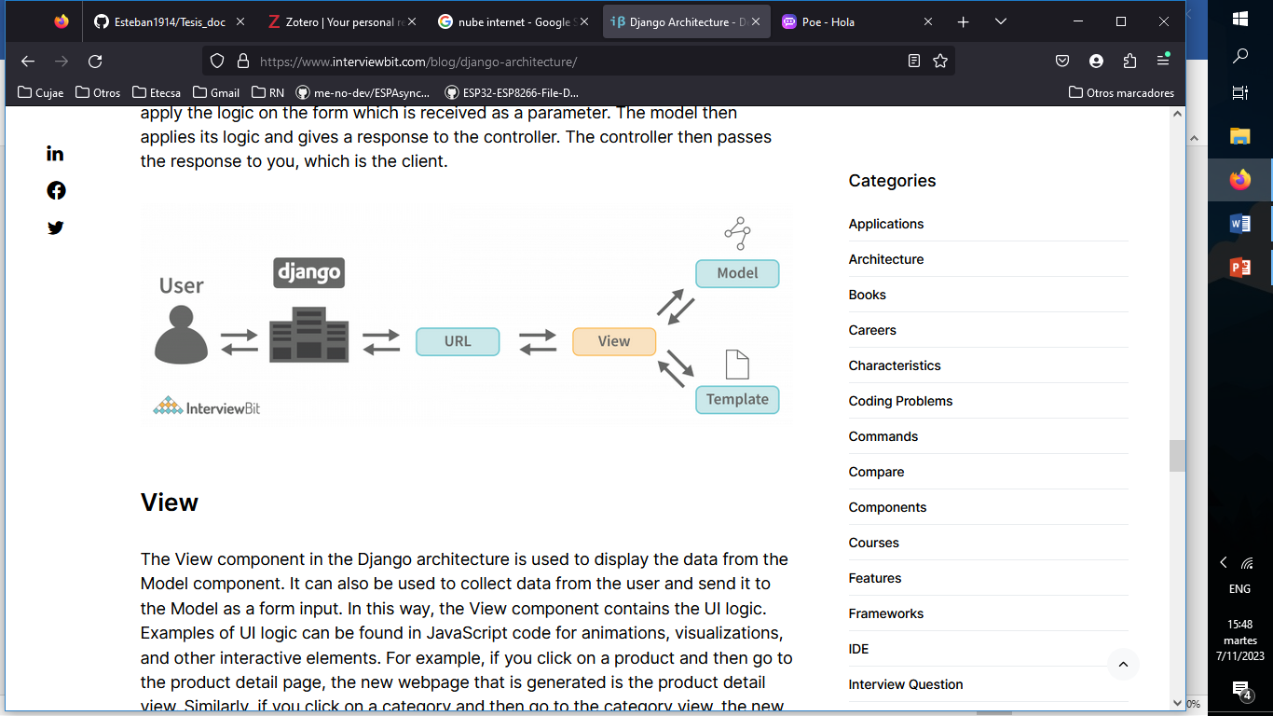

Slide 6
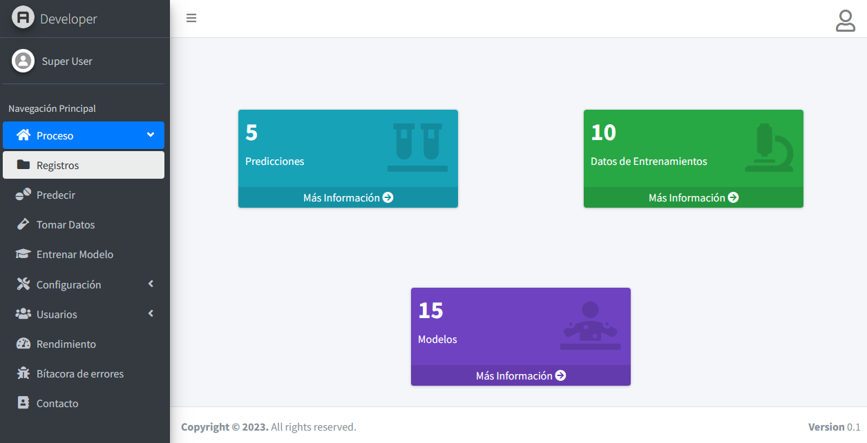

Slide 7
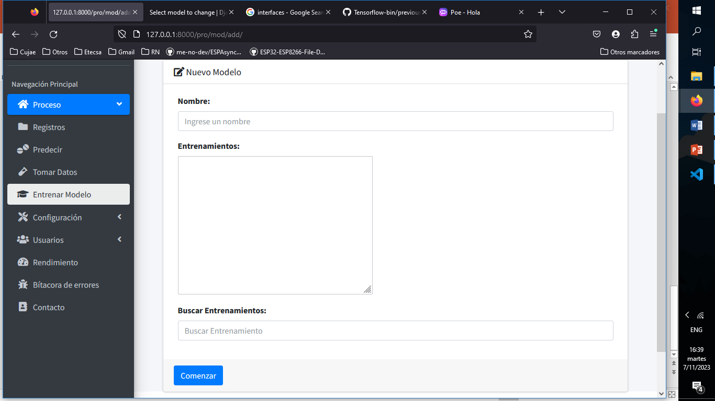
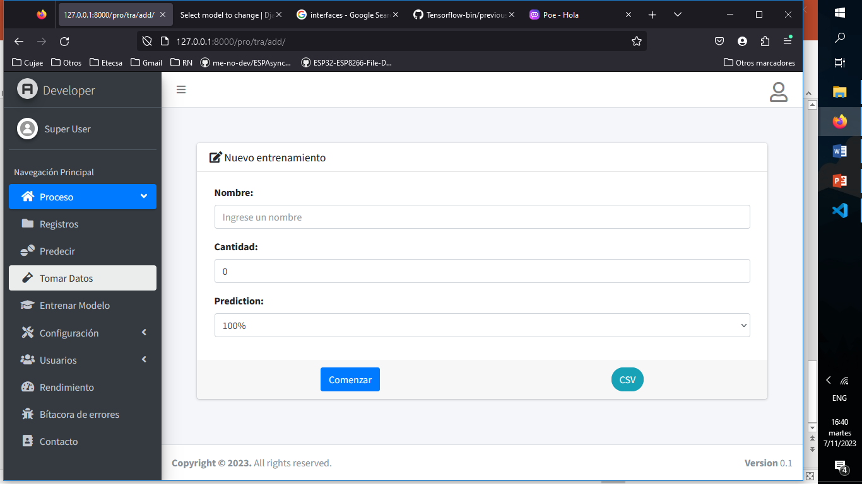

Slide 8
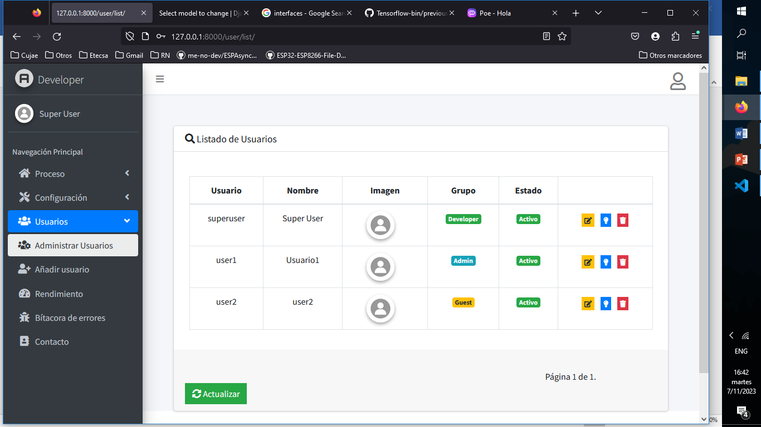


Slide 9
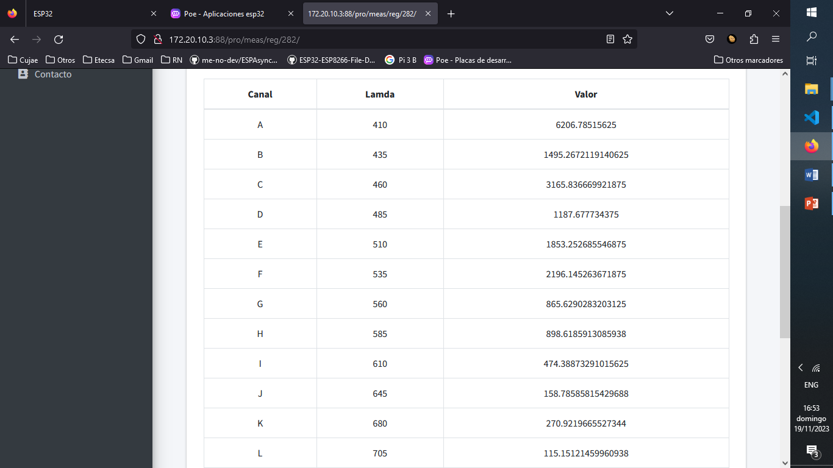
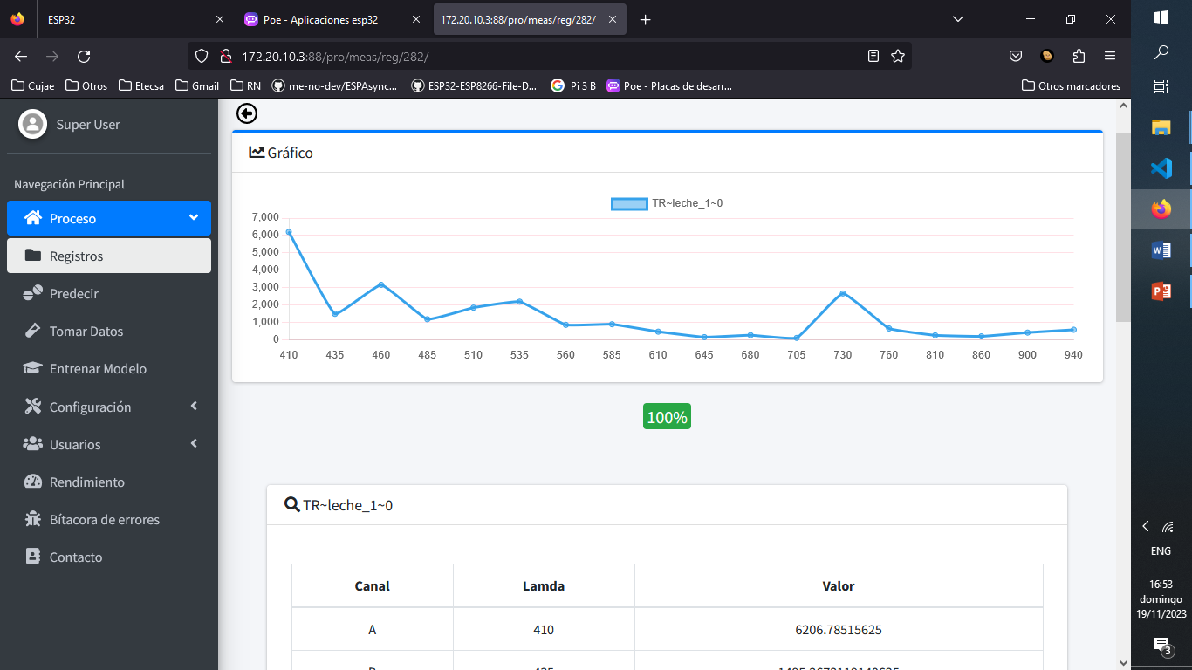

Slide 10








Predicciones
Registros
Muestras
Rendimiento
Modelos
Bitácora
Predecir
Login
Proceso
Tomar Datos
Usuarios
Entrenar
Configuración
Fecha y Hora
Red

Slide 11
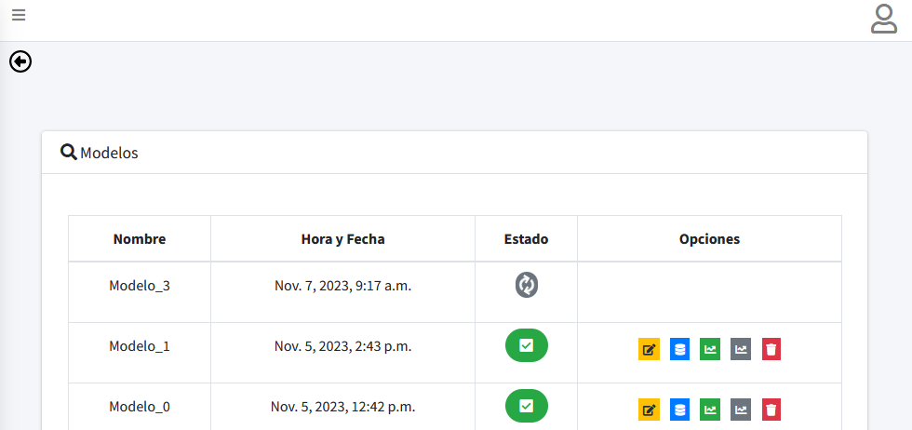

Slide 12







Data
Datos Entrenamiento
Modelo
Muestra
Predicciones
Longitud
Onda
18

Slide 13
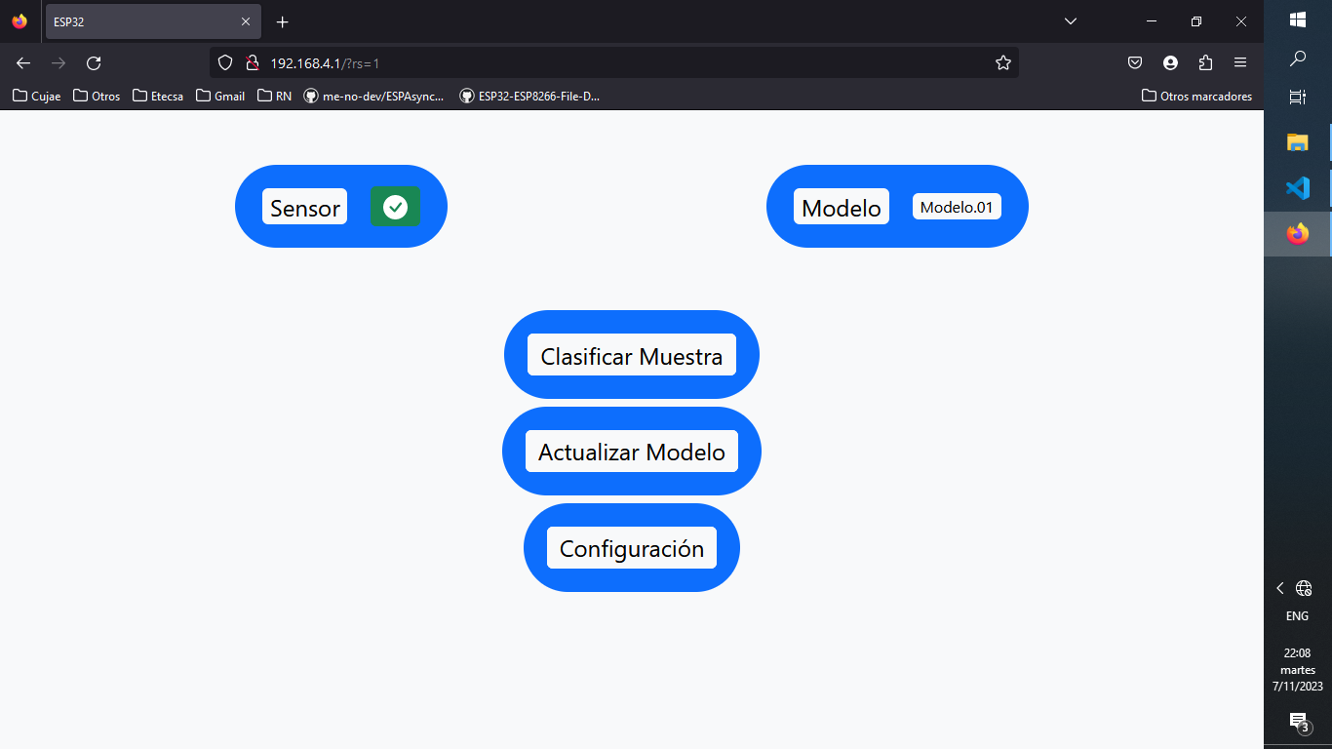
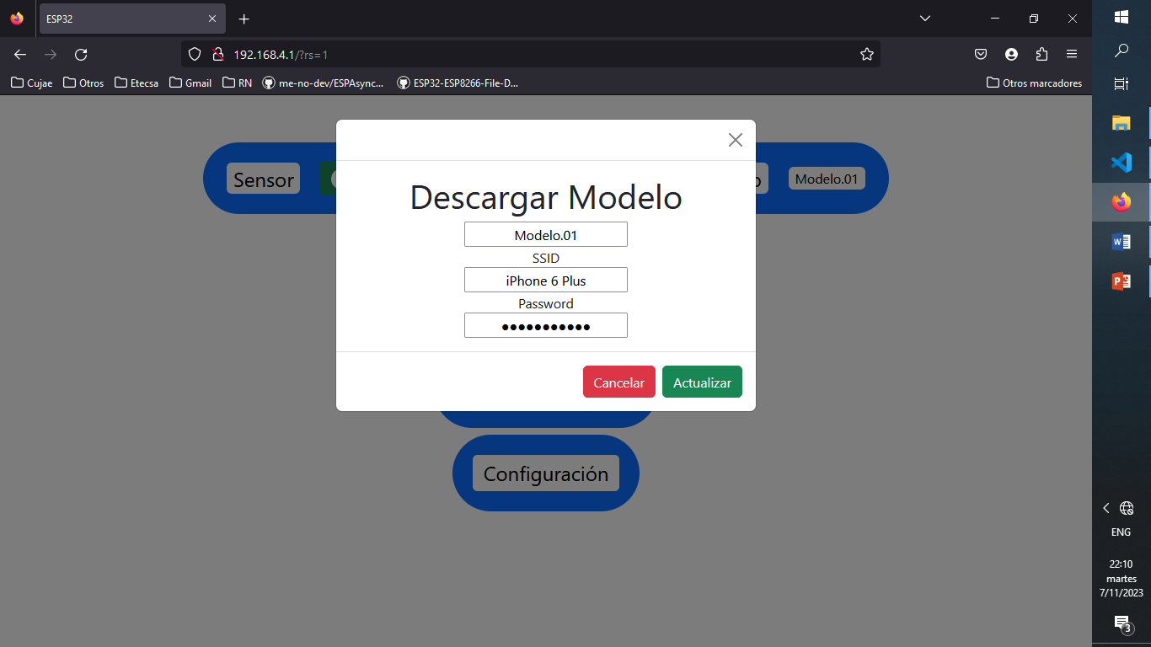
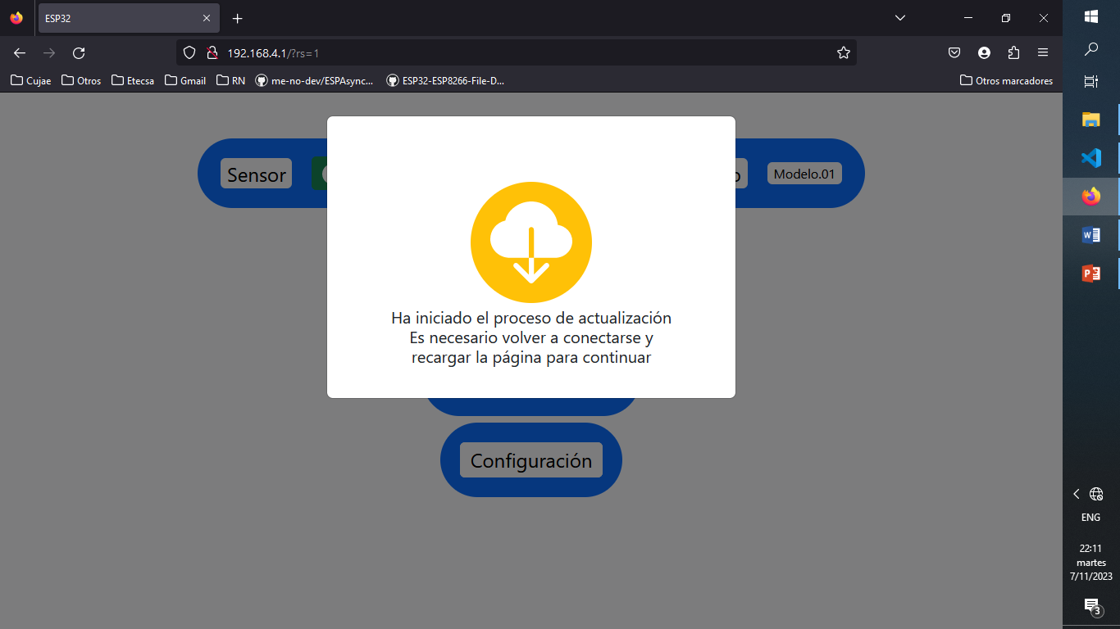
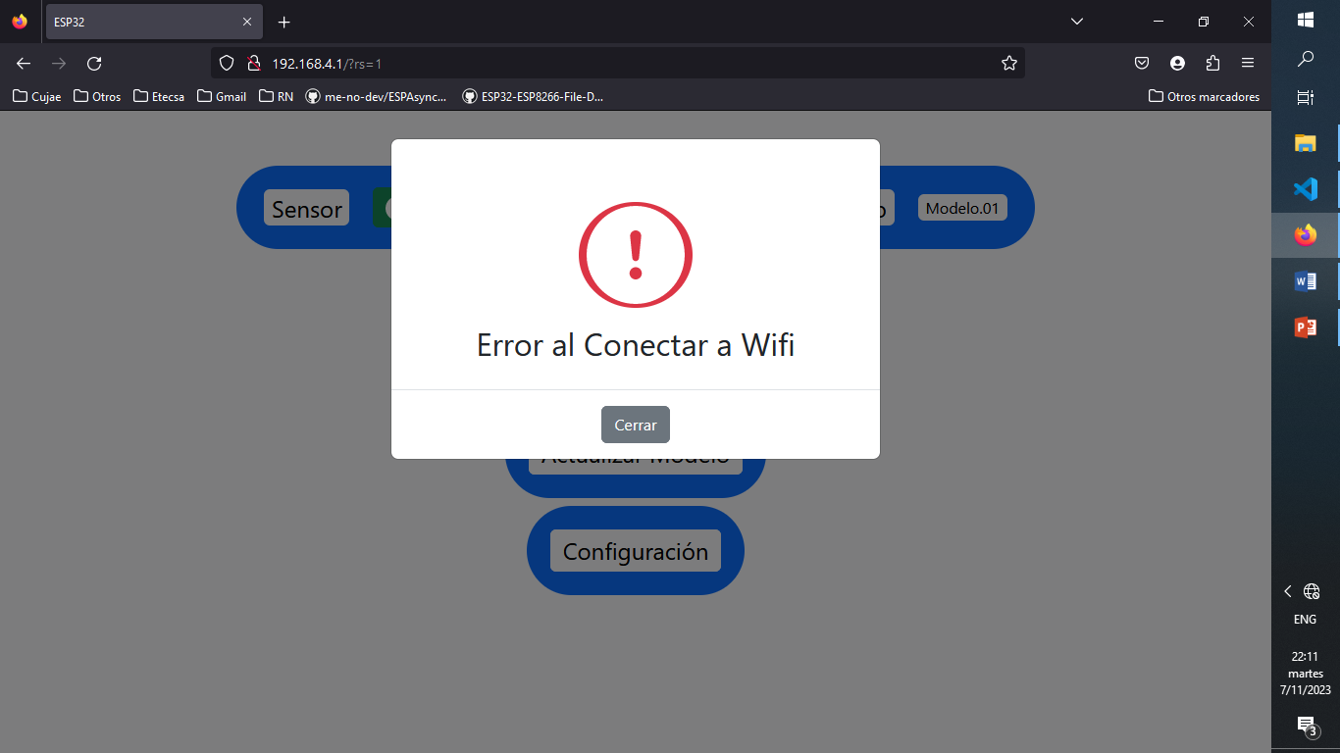

Slide 14
Setup
Loop
Web
No
Bandera
Predicción
Inicializar Variables
Si
Conectar Wifi
Nuevo Modelo
Leer Sensor
Descargar Modelo
No
Si
Cargar modelo
Cargar y Guardar modelo
Calculo Red
Almacenar Modelo
Verificar Errores
Mostrar Resultado
Reiniciar ESP32

Slide 15
Web
Setup
Loop
No
Actualizar Modelo
Predicción
Configuración
Bandera
Descarga
Inicializar Variables
Si
Verificar Parámetros
Leer Sensor
Aplicar Cambios
Conectar Wi-Fi
Cargar Modelo
Descargar Modelo
Activar Bandera Descarga
Cálculo Red Neuronal
Reiniciar Wi-Fi
Iniciar Wi-Fi
Y Servidor Web
Verificar y almacenar Modelo
Mostrar Resultados

Slide 16
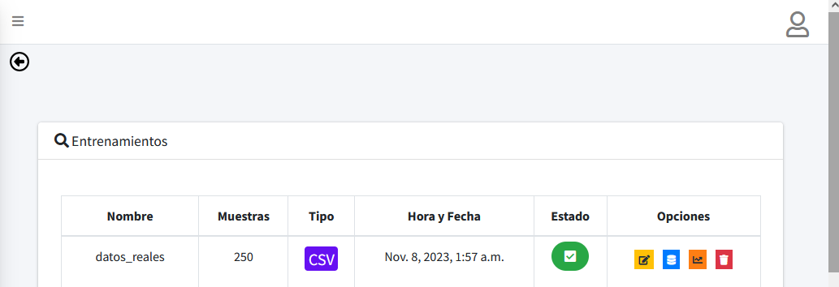

Slide 17
{'units_0': 192, 'activation': 'tanh', 'learning_rate': 0.01, 'tuner/epochs': 50, 'tuner/initial_epoch': 17, 'tuner/bracket': 3, 'tuner/round': 3, 'tuner/trial_id': '0049'}
Model: "sequential_1"
_________________________________________________________________
Layer (type) Output Shape Param #
=================================================================
dense_2 (Dense) (None, 192) 3648
dense_3 (Dense) (None, 5) 965
=================================================================
Total params: 4613 (18.02 KB)
Trainable params: 4613 (18.02 KB)
Non-trainable params: 0 (0.00 Byte)
_________________________________________________________________
RandomSearch
{'units_0': 192, 'activation': 'tanh', 'learning_rate': 0.001}
Model: "sequential_2"
_________________________________________________________________
Layer (type) Output Shape Param #
=================================================================
dense_4 (Dense) (None, 192) 3648
dense_5 (Dense) (None, 5) 965
=================================================================
Total params: 4613 (18.02 KB)
Trainable params: 4613 (18.02 KB)
Non-trainable params: 0 (0.00 Byte)
_________________________________________________________________
Epoch 1/100
7/7 [==============================] - 1s 76ms/step - loss: 1.5246 - accuracy: 0.2800 - val_loss: 1.3124 - val_accuracy: 0.3800
Epoch 2/100
7/7 [==============================] - 0s 15ms/step - loss: 1.3450 - accuracy: 0.4200 - val_loss: 1.1930 - val_accuracy: 0.3200
Epoch 3/100
7/7 [==============================] - 0s 17ms/step - loss: 1.1496 - accuracy: 0.4200 - val_loss: 1.1366 - val_accuracy: 0.3200
Epoch 4/100
7/7 [==============================] - 0s 14ms/step - loss: 1.0608 - accuracy: 0.4200 - val_loss: 1.0724 - val_accuracy: 0.8000
Epoch 5/100
7/7 [==============================] - 0s 14ms/step - loss: 1.0752 - accuracy: 0.5500 - val_loss: 1.0534 - val_accuracy: 0.4000
Epoch 6/100
7/7 [==============================] - 0s 16ms/step - loss: 1.0191 - accuracy: 0.4700 - val_loss: 1.0287 - val_accuracy: 0.6000
Epoch 7/100
7/7 [==============================] - 0s 14ms/step - loss: 0.9733 - accuracy: 0.5550 - val_loss: 0.9519 - val_accuracy: 0.6600
Epoch 8/100
7/7 [==============================] - 0s 14ms/step - loss: 0.9468 - accuracy: 0.6150 - val_loss: 0.9369 - val_accuracy: 0.5600
Epoch 9/100
7/7 [==============================] - 0s 14ms/step - loss: 0.9030 - accuracy: 0.7850 - val_loss: 0.9414 - val_accuracy: 0.5400
Epoch 10/100
7/7 [==============================] - 0s 13ms/step - loss: 0.8761 - accuracy: 0.6050 - val_loss: 0.9464 - val_accuracy: 0.4400
Epoch 11/100
7/7 [==============================] - 0s 15ms/step - loss: 0.8894 - accuracy: 0.5250 - val_loss: 0.8184 - val_accuracy: 0.6400
Epoch 12/100
7/7 [==============================] - 0s 11ms/step - loss: 0.7835 - accuracy: 0.7100 - val_loss: 0.7419 - val_accuracy: 0.7600
Epoch 13/100
7/7 [==============================] - 0s 11ms/step - loss: 0.7607 - accuracy: 0.6800 - val_loss: 0.7158 - val_accuracy: 0.7800
Epoch 14/100
7/7 [==============================] - 0s 11ms/step - loss: 0.7336 - accuracy: 0.8100 - val_loss: 0.6774 - val_accuracy: 0.8000
Epoch 15/100
7/7 [==============================] - 0s 13ms/step - loss: 0.6847 - accuracy: 0.7800 - val_loss: 0.6444 - val_accuracy: 0.8800
Epoch 16/100
7/7 [==============================] - 0s 17ms/step - loss: 0.6490 - accuracy: 0.7050 - val_loss: 0.5926 - val_accuracy: 0.9600
Epoch 17/100
7/7 [==============================] - 0s 16ms/step - loss: 0.6075 - accuracy: 0.7850 - val_loss: 0.5633 - val_accuracy: 0.8000
Epoch 18/100
7/7 [==============================] - 0s 20ms/step - loss: 0.5716 - accuracy: 0.8400 - val_loss: 0.5835 - val_accuracy: 0.8200
Epoch 19/100
7/7 [==============================] - 0s 15ms/step - loss: 0.5440 - accuracy: 0.9050 - val_loss: 0.5487 - val_accuracy: 0.8800
Epoch 20/100
7/7 [==============================] - 0s 18ms/step - loss: 0.5285 - accuracy: 0.8300 - val_loss: 0.5866 - val_accuracy: 0.8600
Epoch 21/100
7/7 [==============================] - 0s 16ms/step - loss: 0.5370 - accuracy: 0.8150 - val_loss: 0.5702 - val_accuracy: 0.6800
Epoch 22/100
7/7 [==============================] - 0s 12ms/step - loss: 0.5245 - accuracy: 0.7700 - val_loss: 0.5464 - val_accuracy: 0.6800
Epoch 23/100
7/7 [==============================] - 0s 15ms/step - loss: 0.5130 - accuracy: 0.7850 - val_loss: 0.4681 - val_accuracy: 0.8600
Epoch 24/100
7/7 [==============================] - 0s 17ms/step - loss: 0.4798 - accuracy: 0.8300 - val_loss: 0.4755 - val_accuracy: 0.8200
Epoch 25/100
7/7 [==============================] - 0s 12ms/step - loss: 0.4582 - accuracy: 0.8950 - val_loss: 0.4216 - val_accuracy: 0.9000
Epoch 26/100
7/7 [==============================] - 0s 14ms/step - loss: 0.4164 - accuracy: 0.9200 - val_loss: 0.4354 - val_accuracy: 0.8800
Epoch 27/100
7/7 [==============================] - 0s 16ms/step - loss: 0.3984 - accuracy: 0.9550 - val_loss: 0.4132 - val_accuracy: 0.8800
Epoch 28/100
7/7 [==============================] - 0s 12ms/step - loss: 0.3957 - accuracy: 0.8450 - val_loss: 0.3866 - val_accuracy: 1.0000
Epoch 29/100
7/7 [==============================] - 0s 11ms/step - loss: 0.3832 - accuracy: 0.9600 - val_loss: 0.4127 - val_accuracy: 0.8800
Epoch 30/100
7/7 [==============================] - 0s 12ms/step - loss: 0.3850 - accuracy: 0.8800 - val_loss: 0.4975 - val_accuracy: 0.6600
Epoch 31/100
7/7 [==============================] - 0s 13ms/step - loss: 0.4002 - accuracy: 0.8800 - val_loss: 0.5187 - val_accuracy: 0.7800
Epoch 32/100
7/7 [==============================] - 0s 13ms/step - loss: 0.3922 - accuracy: 0.8450 - val_loss: 0.4425 - val_accuracy: 0.7400
Epoch 33/100
7/7 [==============================] - 0s 16ms/step - loss: 0.3416 - accuracy: 0.8750 - val_loss: 0.3457 - val_accuracy: 0.8600
Epoch 34/100
7/7 [==============================] - 0s 14ms/step - loss: 0.3166 - accuracy: 0.9050 - val_loss: 0.3184 - val_accuracy: 0.9600
Epoch 35/100
7/7 [==============================] - 0s 15ms/step - loss: 0.3158 - accuracy: 0.9250 - val_loss: 0.3493 - val_accuracy: 0.9000
Epoch 36/100
7/7 [==============================] - 0s 14ms/step - loss: 0.3233 - accuracy: 0.9200 - val_loss: 0.3562 - val_accuracy: 0.8600
Epoch 37/100
7/7 [==============================] - 0s 16ms/step - loss: 0.3309 - accuracy: 0.8850 - val_loss: 0.3938 - val_accuracy: 0.8000
Epoch 38/100
7/7 [==============================] - 0s 17ms/step - loss: 0.3070 - accuracy: 0.8900 - val_loss: 0.3613 - val_accuracy: 0.8800
Epoch 39/100
7/7 [==============================] - 0s 14ms/step - loss: 0.2871 - accuracy: 0.9350 - val_loss: 0.3293 - val_accuracy: 0.9000
Epoch 40/100
7/7 [==============================] - 0s 17ms/step - loss: 0.2778 - accuracy: 0.9250 - val_loss: 0.2578 - val_accuracy: 0.9600
Epoch 41/100
7/7 [==============================] - 0s 15ms/step - loss: 0.3172 - accuracy: 0.8800 - val_loss: 0.2643 - val_accuracy: 0.9000
Epoch 42/100
7/7 [==============================] - 0s 17ms/step - loss: 0.3154 - accuracy: 0.8650 - val_loss: 0.2846 - val_accuracy: 0.9400
Epoch 43/100
7/7 [==============================] - 0s 18ms/step - loss: 0.3435 - accuracy: 0.8600 - val_loss: 0.2907 - val_accuracy: 0.9400
Epoch 44/100
7/7 [==============================] - 0s 15ms/step - loss: 0.2836 - accuracy: 0.9100 - val_loss: 0.2629 - val_accuracy: 0.9000
Epoch 45/100
7/7 [==============================] - 0s 13ms/step - loss: 0.3072 - accuracy: 0.8800 - val_loss: 0.3002 - val_accuracy: 0.9000
Epoch 46/100
7/7 [==============================] - 0s 29ms/step - loss: 0.3076 - accuracy: 0.8600 - val_loss: 0.2640 - val_accuracy: 0.9400
Epoch 47/100
7/7 [==============================] - 0s 12ms/step - loss: 0.3092 - accuracy: 0.8800 - val_loss: 0.2481 - val_accuracy: 0.8400
Epoch 48/100
7/7 [==============================] - 0s 12ms/step - loss: 0.2520 - accuracy: 0.9450 - val_loss: 0.2698 - val_accuracy: 0.8800
Epoch 49/100
7/7 [==============================] - 0s 11ms/step - loss: 0.2497 - accuracy: 0.8850 - val_loss: 0.2363 - val_accuracy: 0.9400
Epoch 50/100
7/7 [==============================] - 0s 14ms/step - loss: 0.2607 - accuracy: 0.9350 - val_loss: 0.2471 - val_accuracy: 0.9400
Epoch 51/100
7/7 [==============================] - 0s 14ms/step - loss: 0.2636 - accuracy: 0.9000 - val_loss: 0.2069 - val_accuracy: 0.9800
Epoch 52/100
7/7 [==============================] - 0s 14ms/step - loss: 0.2531 - accuracy: 0.9150 - val_loss: 0.2006 - val_accuracy: 0.9800
Epoch 53/100
7/7 [==============================] - 0s 13ms/step - loss: 0.2343 - accuracy: 0.9300 - val_loss: 0.2131 - val_accuracy: 0.8600
Epoch 54/100
7/7 [==============================] - 0s 12ms/step - loss: 0.2196 - accuracy: 0.9400 - val_loss: 0.1948 - val_accuracy: 1.0000
Epoch 55/100
7/7 [==============================] - 0s 13ms/step - loss: 0.2192 - accuracy: 0.9300 - val_loss: 0.2184 - val_accuracy: 1.0000
Epoch 56/100
7/7 [==============================] - 0s 14ms/step - loss: 0.1930 - accuracy: 0.9850 - val_loss: 0.1944 - val_accuracy: 0.9800
Epoch 57/100
7/7 [==============================] - 0s 13ms/step - loss: 0.1922 - accuracy: 0.9750 - val_loss: 0.2164 - val_accuracy: 0.9000
Epoch 58/100
7/7 [==============================] - 0s 15ms/step - loss: 0.1904 - accuracy: 0.9650 - val_loss: 0.2137 - val_accuracy: 0.9000
Epoch 59/100
7/7 [==============================] - 0s 15ms/step - loss: 0.2109 - accuracy: 0.9250 - val_loss: 0.1823 - val_accuracy: 0.9600
Epoch 60/100
7/7 [==============================] - 0s 19ms/step - loss: 0.2089 - accuracy: 0.9500 - val_loss: 0.1831 - val_accuracy: 0.9400
Epoch 61/100
7/7 [==============================] - 0s 17ms/step - loss: 0.2280 - accuracy: 0.9150 - val_loss: 0.1942 - val_accuracy: 0.9000
Epoch 62/100
7/7 [==============================] - 0s 12ms/step - loss: 0.1808 - accuracy: 0.9350 - val_loss: 0.1838 - val_accuracy: 0.9600
Epoch 63/100
7/7 [==============================] - 0s 14ms/step - loss: 0.1752 - accuracy: 0.9650 - val_loss: 0.1651 - val_accuracy: 1.0000
Epoch 64/100
7/7 [==============================] - 0s 14ms/step - loss: 0.1559 - accuracy: 0.9750 - val_loss: 0.2551 - val_accuracy: 0.9000
Epoch 65/100
7/7 [==============================] - 0s 17ms/step - loss: 0.2082 - accuracy: 0.9250 - val_loss: 0.4333 - val_accuracy: 0.6800
Epoch 66/100
7/7 [==============================] - 0s 16ms/step - loss: 0.2014 - accuracy: 0.9200 - val_loss: 0.4378 - val_accuracy: 0.8600
Epoch 67/100
7/7 [==============================] - 0s 16ms/step - loss: 0.2890 - accuracy: 0.8700 - val_loss: 0.4439 - val_accuracy: 0.6800
Epoch 68/100
7/7 [==============================] - 0s 14ms/step - loss: 0.2520 - accuracy: 0.8750 - val_loss: 0.4670 - val_accuracy: 0.6600
Epoch 69/100
7/7 [==============================] - 0s 12ms/step - loss: 0.3862 - accuracy: 0.8100 - val_loss: 0.1795 - val_accuracy: 0.9000
Epoch 70/100
7/7 [==============================] - 0s 11ms/step - loss: 0.3446 - accuracy: 0.8050 - val_loss: 0.1677 - val_accuracy: 0.9600
Epoch 71/100
7/7 [==============================] - 0s 11ms/step - loss: 0.2735 - accuracy: 0.8850 - val_loss: 0.1956 - val_accuracy: 0.9400
Epoch 72/100
7/7 [==============================] - 0s 13ms/step - loss: 0.2310 - accuracy: 0.8950 - val_loss: 0.2468 - val_accuracy: 0.9400
Epoch 73/100
7/7 [==============================] - 0s 14ms/step - loss: 0.2206 - accuracy: 0.8850 - val_loss: 0.2762 - val_accuracy: 0.8600
Epoch 74/100
7/7 [==============================] - 0s 13ms/step - loss: 0.1712 - accuracy: 0.9500 - val_loss: 0.2685 - val_accuracy: 0.8800
Epoch 75/100
7/7 [==============================] - 0s 14ms/step - loss: 0.1676 - accuracy: 0.9500 - val_loss: 0.1499 - val_accuracy: 0.9800
Epoch 76/100
7/7 [==============================] - 0s 14ms/step - loss: 0.1597 - accuracy: 0.9600 - val_loss: 0.1855 - val_accuracy: 0.9600
Epoch 77/100
7/7 [==============================] - 0s 13ms/step - loss: 0.1467 - accuracy: 0.9600 - val_loss: 0.1510 - val_accuracy: 0.9200
Epoch 78/100
7/7 [==============================] - 0s 11ms/step - loss: 0.1167 - accuracy: 0.9950 - val_loss: 0.1574 - val_accuracy: 1.0000
Epoch 79/100
7/7 [==============================] - 0s 14ms/step - loss: 0.1228 - accuracy: 0.9800 - val_loss: 0.1248 - val_accuracy: 1.0000
Epoch 80/100
7/7 [==============================] - 0s 13ms/step - loss: 0.1193 - accuracy: 0.9950 - val_loss: 0.1505 - val_accuracy: 0.9200
Epoch 81/100
7/7 [==============================] - 0s 19ms/step - loss: 0.1112 - accuracy: 0.9750 - val_loss: 0.1875 - val_accuracy: 0.9400
Epoch 82/100
7/7 [==============================] - 0s 13ms/step - loss: 0.2043 - accuracy: 0.9050 - val_loss: 0.1197 - val_accuracy: 0.9600
Epoch 83/100
7/7 [==============================] - 0s 15ms/step - loss: 0.2085 - accuracy: 0.9000 - val_loss: 0.4791 - val_accuracy: 0.8600
Epoch 84/100
7/7 [==============================] - 0s 18ms/step - loss: 0.1993 - accuracy: 0.9450 - val_loss: 0.2726 - val_accuracy: 0.8800
Epoch 85/100
7/7 [==============================] - 0s 14ms/step - loss: 0.1818 - accuracy: 0.9500 - val_loss: 0.1213 - val_accuracy: 1.0000
Epoch 86/100
7/7 [==============================] - 0s 16ms/step - loss: 0.1266 - accuracy: 0.9550 - val_loss: 0.1234 - val_accuracy: 0.9600
Epoch 87/100
7/7 [==============================] - 0s 14ms/step - loss: 0.1449 - accuracy: 0.9650 - val_loss: 0.1272 - val_accuracy: 1.0000
Epoch 88/100
7/7 [==============================] - 0s 12ms/step - loss: 0.1259 - accuracy: 0.9750 - val_loss: 0.2195 - val_accuracy: 0.8600
Epoch 89/100
7/7 [==============================] - 0s 16ms/step - loss: 0.1390 - accuracy: 0.9650 - val_loss: 0.1046 - val_accuracy: 1.0000
Epoch 90/100
7/7 [==============================] - 0s 15ms/step - loss: 0.1047 - accuracy: 0.9750 - val_loss: 0.1330 - val_accuracy: 0.9600
Epoch 91/100
7/7 [==============================] - 0s 13ms/step - loss: 0.1046 - accuracy: 0.9850 - val_loss: 0.3201 - val_accuracy: 0.8600
Epoch 92/100
7/7 [==============================] - 0s 15ms/step - loss: 0.1553 - accuracy: 0.9350 - val_loss: 0.1440 - val_accuracy: 0.9000
Epoch 93/100
7/7 [==============================] - 0s 14ms/step - loss: 0.1337 - accuracy: 0.9550 - val_loss: 0.1065 - val_accuracy: 1.0000
Epoch 94/100
7/7 [==============================] - 0s 13ms/step - loss: 0.1066 - accuracy: 0.9700 - val_loss: 0.1044 - val_accuracy: 1.0000
Epoch 95/100
7/7 [==============================] - 0s 14ms/step - loss: 0.0985 - accuracy: 0.9800 - val_loss: 0.1200 - val_accuracy: 0.9800
Epoch 96/100
7/7 [==============================] - 0s 13ms/step - loss: 0.1013 - accuracy: 0.9800 - val_loss: 0.1078 - val_accuracy: 0.9600
Epoch 97/100
7/7 [==============================] - 0s 12ms/step - loss: 0.1176 - accuracy: 0.9600 - val_loss: 0.1525 - val_accuracy: 1.0000
Epoch 98/100
7/7 [==============================] - 0s 11ms/step - loss: 0.1127 - accuracy: 0.9800 - val_loss: 0.2868 - val_accuracy: 0.8200
Epoch 99/100
7/7 [==============================] - 0s 14ms/step - loss: 0.1794 - accuracy: 0.9100 - val_loss: 0.1363 - val_accuracy: 0.9000
Epoch 100/100
7/7 [==============================] - 0s 14ms/step - loss: 0.1031 - accuracy: 0.9600 - val_loss: 0.1345 - val_accuracy: 0.9600
MT
10.703981399536133
Epoch 1/100
7/7 [==============================] - 1s 46ms/step - loss: 1.5971 - accuracy: 0.2050 - val_loss: 1.5293 - val_accuracy: 0.2000
Epoch 2/100
7/7 [==============================] - 0s 18ms/step - loss: 1.5208 - accuracy: 0.2050 - val_loss: 1.4930 - val_accuracy: 0.3200
Epoch 3/100
7/7 [==============================] - 0s 14ms/step - loss: 1.4740 - accuracy: 0.4200 - val_loss: 1.4635 - val_accuracy: 0.3200
Epoch 4/100
7/7 [==============================] - 0s 18ms/step - loss: 1.4499 - accuracy: 0.4200 - val_loss: 1.4461 - val_accuracy: 0.3200
Epoch 5/100
7/7 [==============================] - 0s 12ms/step - loss: 1.4239 - accuracy: 0.4650 - val_loss: 1.4142 - val_accuracy: 0.4000
Epoch 6/100
7/7 [==============================] - 0s 14ms/step - loss: 1.3958 - accuracy: 0.4650 - val_loss: 1.3954 - val_accuracy: 0.3200
Epoch 7/100
7/7 [==============================] - 0s 14ms/step - loss: 1.3723 - accuracy: 0.4200 - val_loss: 1.3767 - val_accuracy: 0.3200
Epoch 8/100
7/7 [==============================] - 0s 13ms/step - loss: 1.3507 - accuracy: 0.4200 - val_loss: 1.3556 - val_accuracy: 0.3200
Epoch 9/100
7/7 [==============================] - 0s 17ms/step - loss: 1.3289 - accuracy: 0.4200 - val_loss: 1.3368 - val_accuracy: 0.3200
Epoch 10/100
7/7 [==============================] - 0s 13ms/step - loss: 1.3061 - accuracy: 0.4350 - val_loss: 1.3085 - val_accuracy: 0.5400
Epoch 11/100
7/7 [==============================] - 0s 10ms/step - loss: 1.2833 - accuracy: 0.6450 - val_loss: 1.2770 - val_accuracy: 0.8000
Epoch 12/100
7/7 [==============================] - 0s 12ms/step - loss: 1.2554 - accuracy: 0.6750 - val_loss: 1.2602 - val_accuracy: 0.5400
Epoch 13/100
7/7 [==============================] - 0s 13ms/step - loss: 1.2339 - accuracy: 0.6150 - val_loss: 1.2484 - val_accuracy: 0.5400
Epoch 14/100
7/7 [==============================] - 0s 11ms/step - loss: 1.2100 - accuracy: 0.5050 - val_loss: 1.2346 - val_accuracy: 0.3200
Epoch 15/100
7/7 [==============================] - 0s 12ms/step - loss: 1.1878 - accuracy: 0.4200 - val_loss: 1.2035 - val_accuracy: 0.3200
Epoch 16/100
7/7 [==============================] - 0s 11ms/step - loss: 1.1661 - accuracy: 0.5800 - val_loss: 1.1756 - val_accuracy: 0.7600
Epoch 17/100
7/7 [==============================] - 0s 16ms/step - loss: 1.1557 - accuracy: 0.5500 - val_loss: 1.1589 - val_accuracy: 0.3800
Epoch 18/100
7/7 [==============================] - 0s 17ms/step - loss: 1.1414 - accuracy: 0.4050 - val_loss: 1.1516 - val_accuracy: 0.3800
Epoch 19/100
7/7 [==============================] - 0s 15ms/step - loss: 1.1253 - accuracy: 0.3650 - val_loss: 1.1474 - val_accuracy: 0.3200
Epoch 20/100
7/7 [==============================] - 0s 13ms/step - loss: 1.1093 - accuracy: 0.5300 - val_loss: 1.1450 - val_accuracy: 0.5400
Epoch 21/100
7/7 [==============================] - 0s 14ms/step - loss: 1.0989 - accuracy: 0.5900 - val_loss: 1.1393 - val_accuracy: 0.4800
Epoch 22/100
7/7 [==============================] - 0s 17ms/step - loss: 1.0918 - accuracy: 0.6050 - val_loss: 1.1163 - val_accuracy: 0.5400
Epoch 23/100
7/7 [==============================] - 0s 16ms/step - loss: 1.0799 - accuracy: 0.6350 - val_loss: 1.1074 - val_accuracy: 0.6000
Epoch 24/100
7/7 [==============================] - 0s 15ms/step - loss: 1.0724 - accuracy: 0.6800 - val_loss: 1.0952 - val_accuracy: 0.6000
Epoch 25/100
7/7 [==============================] - 0s 17ms/step - loss: 1.0620 - accuracy: 0.6250 - val_loss: 1.0787 - val_accuracy: 0.6600
Epoch 26/100
7/7 [==============================] - 0s 13ms/step - loss: 1.0603 - accuracy: 0.5850 - val_loss: 1.0669 - val_accuracy: 0.6600
Epoch 27/100
7/7 [==============================] - 0s 14ms/step - loss: 1.0516 - accuracy: 0.5900 - val_loss: 1.0681 - val_accuracy: 0.7600
Epoch 28/100
7/7 [==============================] - 0s 11ms/step - loss: 1.0440 - accuracy: 0.7050 - val_loss: 1.0652 - val_accuracy: 0.8000
Epoch 29/100
7/7 [==============================] - 0s 16ms/step - loss: 1.0354 - accuracy: 0.7250 - val_loss: 1.0735 - val_accuracy: 0.5400
Epoch 30/100
7/7 [==============================] - 0s 10ms/step - loss: 1.0348 - accuracy: 0.6150 - val_loss: 1.0726 - val_accuracy: 0.5400
Epoch 31/100
7/7 [==============================] - 0s 12ms/step - loss: 1.0271 - accuracy: 0.6250 - val_loss: 1.0487 - val_accuracy: 0.7400
Epoch 32/100
7/7 [==============================] - 0s 14ms/step - loss: 1.0210 - accuracy: 0.7200 - val_loss: 1.0447 - val_accuracy: 0.6000
Epoch 33/100
7/7 [==============================] - 0s 13ms/step - loss: 1.0140 - accuracy: 0.6150 - val_loss: 1.0292 - val_accuracy: 0.8600
Epoch 34/100
7/7 [==============================] - 0s 12ms/step - loss: 1.0078 - accuracy: 0.8250 - val_loss: 1.0268 - val_accuracy: 0.8600
Epoch 35/100
7/7 [==============================] - 0s 12ms/step - loss: 0.9990 - accuracy: 0.7450 - val_loss: 1.0388 - val_accuracy: 0.5400
Epoch 36/100
7/7 [==============================] - 0s 11ms/step - loss: 1.0009 - accuracy: 0.6150 - val_loss: 1.0376 - val_accuracy: 0.5400
Epoch 37/100
7/7 [==============================] - 0s 14ms/step - loss: 0.9922 - accuracy: 0.6150 - val_loss: 1.0265 - val_accuracy: 0.5400
Epoch 38/100
7/7 [==============================] - 0s 12ms/step - loss: 0.9855 - accuracy: 0.6300 - val_loss: 1.0118 - val_accuracy: 0.8000
Epoch 39/100
7/7 [==============================] - 0s 14ms/step - loss: 0.9799 - accuracy: 0.7750 - val_loss: 1.0034 - val_accuracy: 0.8600
Epoch 40/100
7/7 [==============================] - 0s 16ms/step - loss: 0.9705 - accuracy: 0.8650 - val_loss: 0.9888 - val_accuracy: 0.8000
Epoch 41/100
7/7 [==============================] - 0s 15ms/step - loss: 0.9685 - accuracy: 0.8800 - val_loss: 0.9815 - val_accuracy: 1.0000
Epoch 42/100
7/7 [==============================] - 0s 15ms/step - loss: 0.9607 - accuracy: 0.9650 - val_loss: 0.9744 - val_accuracy: 0.8600
Epoch 43/100
7/7 [==============================] - 0s 18ms/step - loss: 0.9563 - accuracy: 0.8150 - val_loss: 0.9678 - val_accuracy: 0.8000
Epoch 44/100
7/7 [==============================] - 0s 13ms/step - loss: 0.9521 - accuracy: 0.7950 - val_loss: 0.9785 - val_accuracy: 0.6400
Epoch 45/100
7/7 [==============================] - 0s 16ms/step - loss: 0.9485 - accuracy: 0.6500 - val_loss: 0.9756 - val_accuracy: 0.5600
Epoch 46/100
7/7 [==============================] - 0s 13ms/step - loss: 0.9400 - accuracy: 0.7150 - val_loss: 0.9674 - val_accuracy: 0.8600
Epoch 47/100
7/7 [==============================] - 0s 15ms/step - loss: 0.9349 - accuracy: 0.9050 - val_loss: 0.9521 - val_accuracy: 0.9000
Epoch 48/100
7/7 [==============================] - 0s 16ms/step - loss: 0.9266 - accuracy: 0.8950 - val_loss: 0.9440 - val_accuracy: 0.7600
Epoch 49/100
7/7 [==============================] - 0s 17ms/step - loss: 0.9186 - accuracy: 0.8900 - val_loss: 0.9264 - val_accuracy: 0.9400
Epoch 50/100
7/7 [==============================] - 0s 12ms/step - loss: 0.9216 - accuracy: 0.7900 - val_loss: 0.9300 - val_accuracy: 0.8000
Epoch 51/100
7/7 [==============================] - 0s 11ms/step - loss: 0.9091 - accuracy: 0.8000 - val_loss: 0.9209 - val_accuracy: 0.8000
Epoch 52/100
7/7 [==============================] - 0s 11ms/step - loss: 0.9017 - accuracy: 0.8000 - val_loss: 0.9270 - val_accuracy: 0.8000
Epoch 53/100
7/7 [==============================] - 0s 11ms/step - loss: 0.8951 - accuracy: 0.8000 - val_loss: 0.9170 - val_accuracy: 0.8000
Epoch 54/100
7/7 [==============================] - 0s 12ms/step - loss: 0.8930 - accuracy: 0.8600 - val_loss: 0.8981 - val_accuracy: 0.9400
Epoch 55/100
7/7 [==============================] - 0s 11ms/step - loss: 0.8841 - accuracy: 0.8200 - val_loss: 0.8918 - val_accuracy: 1.0000
Epoch 56/100
7/7 [==============================] - 0s 11ms/step - loss: 0.8770 - accuracy: 0.8300 - val_loss: 0.9050 - val_accuracy: 0.6000
Epoch 57/100
7/7 [==============================] - 0s 11ms/step - loss: 0.8738 - accuracy: 0.7250 - val_loss: 0.8952 - val_accuracy: 0.6000
Epoch 58/100
7/7 [==============================] - 0s 14ms/step - loss: 0.8665 - accuracy: 0.8700 - val_loss: 0.8814 - val_accuracy: 0.8200
Epoch 59/100
7/7 [==============================] - 0s 15ms/step - loss: 0.8573 - accuracy: 0.8300 - val_loss: 0.8804 - val_accuracy: 0.8000
Epoch 60/100
7/7 [==============================] - 0s 13ms/step - loss: 0.8552 - accuracy: 0.8000 - val_loss: 0.8540 - val_accuracy: 0.8000
Epoch 61/100
7/7 [==============================] - 0s 14ms/step - loss: 0.8497 - accuracy: 0.8000 - val_loss: 0.8508 - val_accuracy: 0.8000
Epoch 62/100
7/7 [==============================] - 0s 16ms/step - loss: 0.8464 - accuracy: 0.7500 - val_loss: 0.8368 - val_accuracy: 0.7600
Epoch 63/100
7/7 [==============================] - 0s 17ms/step - loss: 0.8326 - accuracy: 0.7900 - val_loss: 0.8492 - val_accuracy: 0.8000
Epoch 64/100
7/7 [==============================] - 0s 15ms/step - loss: 0.8323 - accuracy: 0.8000 - val_loss: 0.8440 - val_accuracy: 0.8000
Epoch 65/100
7/7 [==============================] - 0s 13ms/step - loss: 0.8270 - accuracy: 0.8050 - val_loss: 0.8295 - val_accuracy: 0.8600
Epoch 66/100
7/7 [==============================] - 0s 17ms/step - loss: 0.8239 - accuracy: 0.8150 - val_loss: 0.8190 - val_accuracy: 1.0000
Epoch 67/100
7/7 [==============================] - 0s 13ms/step - loss: 0.8114 - accuracy: 0.9500 - val_loss: 0.8248 - val_accuracy: 0.8600
Epoch 68/100
7/7 [==============================] - 0s 14ms/step - loss: 0.8050 - accuracy: 0.9150 - val_loss: 0.8224 - val_accuracy: 0.8400
Epoch 69/100
7/7 [==============================] - 0s 14ms/step - loss: 0.8035 - accuracy: 0.8350 - val_loss: 0.8035 - val_accuracy: 0.8000
Epoch 70/100
7/7 [==============================] - 0s 16ms/step - loss: 0.7948 - accuracy: 0.8000 - val_loss: 0.8051 - val_accuracy: 0.8000
Epoch 71/100
7/7 [==============================] - 0s 17ms/step - loss: 0.7915 - accuracy: 0.8150 - val_loss: 0.7955 - val_accuracy: 0.8000
Epoch 72/100
7/7 [==============================] - 0s 17ms/step - loss: 0.7808 - accuracy: 0.8100 - val_loss: 0.7883 - val_accuracy: 0.8000
Epoch 73/100
7/7 [==============================] - 0s 13ms/step - loss: 0.7748 - accuracy: 0.8300 - val_loss: 0.7871 - val_accuracy: 0.8600
Epoch 74/100
7/7 [==============================] - 0s 14ms/step - loss: 0.7693 - accuracy: 0.9350 - val_loss: 0.7801 - val_accuracy: 0.9200
Epoch 75/100
7/7 [==============================] - 0s 14ms/step - loss: 0.7656 - accuracy: 0.9200 - val_loss: 0.7821 - val_accuracy: 0.8800
Epoch 76/100
7/7 [==============================] - 0s 16ms/step - loss: 0.7620 - accuracy: 0.9000 - val_loss: 0.7665 - val_accuracy: 0.8000
Epoch 77/100
7/7 [==============================] - 0s 12ms/step - loss: 0.7521 - accuracy: 0.8800 - val_loss: 0.7552 - val_accuracy: 0.8800
Epoch 78/100
7/7 [==============================] - 0s 14ms/step - loss: 0.7478 - accuracy: 0.9400 - val_loss: 0.7523 - val_accuracy: 0.9000
Epoch 79/100
7/7 [==============================] - 0s 15ms/step - loss: 0.7432 - accuracy: 0.9750 - val_loss: 0.7505 - val_accuracy: 0.9000
Epoch 80/100
7/7 [==============================] - 0s 13ms/step - loss: 0.7408 - accuracy: 0.9100 - val_loss: 0.7499 - val_accuracy: 0.8600
Epoch 81/100
7/7 [==============================] - 0s 17ms/step - loss: 0.7299 - accuracy: 0.9650 - val_loss: 0.7337 - val_accuracy: 1.0000
Epoch 82/100
7/7 [==============================] - 0s 12ms/step - loss: 0.7268 - accuracy: 0.9650 - val_loss: 0.7183 - val_accuracy: 0.9400
Epoch 83/100
7/7 [==============================] - 0s 13ms/step - loss: 0.7226 - accuracy: 0.8650 - val_loss: 0.7150 - val_accuracy: 0.8400
Epoch 84/100
7/7 [==============================] - 0s 14ms/step - loss: 0.7160 - accuracy: 0.8850 - val_loss: 0.7254 - val_accuracy: 0.9000
Epoch 85/100
7/7 [==============================] - 0s 17ms/step - loss: 0.7123 - accuracy: 0.9100 - val_loss: 0.7181 - val_accuracy: 0.8800
Epoch 86/100
7/7 [==============================] - 0s 15ms/step - loss: 0.7068 - accuracy: 0.9300 - val_loss: 0.7170 - val_accuracy: 0.9000
Epoch 87/100
7/7 [==============================] - 0s 14ms/step - loss: 0.7042 - accuracy: 0.9750 - val_loss: 0.6959 - val_accuracy: 0.9400
Epoch 88/100
7/7 [==============================] - 0s 13ms/step - loss: 0.7012 - accuracy: 0.9350 - val_loss: 0.6957 - val_accuracy: 1.0000
Epoch 89/100
7/7 [==============================] - 0s 14ms/step - loss: 0.6916 - accuracy: 0.9750 - val_loss: 0.6993 - val_accuracy: 0.8600
Epoch 90/100
7/7 [==============================] - 0s 17ms/step - loss: 0.6876 - accuracy: 0.8700 - val_loss: 0.7094 - val_accuracy: 0.8000
Epoch 91/100
7/7 [==============================] - 0s 17ms/step - loss: 0.6860 - accuracy: 0.8650 - val_loss: 0.7028 - val_accuracy: 0.8400
Epoch 92/100
7/7 [==============================] - 0s 13ms/step - loss: 0.6821 - accuracy: 0.8900 - val_loss: 0.6782 - val_accuracy: 0.9600
Epoch 93/100
7/7 [==============================] - 0s 14ms/step - loss: 0.6755 - accuracy: 0.9300 - val_loss: 0.6834 - val_accuracy: 0.9000
Epoch 94/100
7/7 [==============================] - 0s 16ms/step - loss: 0.6716 - accuracy: 0.8900 - val_loss: 0.6613 - val_accuracy: 0.9400
Epoch 95/100
7/7 [==============================] - 0s 17ms/step - loss: 0.6750 - accuracy: 0.8600 - val_loss: 0.6604 - val_accuracy: 0.9400
Epoch 96/100
7/7 [==============================] - 0s 14ms/step - loss: 0.6694 - accuracy: 0.8800 - val_loss: 0.6836 - val_accuracy: 0.8600
Epoch 97/100
7/7 [==============================] - 0s 13ms/step - loss: 0.6571 - accuracy: 0.9250 - val_loss: 0.6568 - val_accuracy: 1.0000
Epoch 98/100
7/7 [==============================] - 0s 11ms/step - loss: 0.6589 - accuracy: 0.9100 - val_loss: 0.6417 - val_accuracy: 0.9400
Epoch 99/100
7/7 [==============================] - 0s 12ms/step - loss: 0.6545 - accuracy: 0.9400 - val_loss: 0.6638 - val_accuracy: 0.9000
Epoch 100/100
7/7 [==============================] - 0s 12ms/step - loss: 0.6428 - accuracy: 0.9700 - val_loss: 0.6410 - val_accuracy: 0.9800
MT1
10.268298864364624
2/2 [==============================] - 0s 4ms/step - loss: 0.1345 - accuracy: 0.9600
2/2 [==============================] - 0s 4ms/step - loss: 0.6410 - accuracy: 0.9800
Error:
Trial 5 Complete [00h 00m 14s]
val_accuracy: 0.8599999845027924
Best val_accuracy So Far: 0.9900000095367432
Total elapsed time: 00h 01m 05s
Hyperband
{'units_0': 288, 'activation': 'tanh', 'dropout': False, 'learning_rate': 0.01, 'tuner/epochs': 50, 'tuner/initial_epoch': 17, 'tuner/bracket': 3, 'tuner/round': 3, 'tuner/trial_id': '0046'}
Model: "sequential_1"
_________________________________________________________________
Layer (type) Output Shape Param #
=================================================================
dense_2 (Dense) (None, 288) 5472
dense_3 (Dense) (None, 5) 1445
=================================================================
Total params: 6917 (27.02 KB)
Trainable params: 6917 (27.02 KB)
Non-trainable params: 0 (0.00 Byte)
_________________________________________________________________
RandomSearch
{'units_0': 224, 'activation': 'relu', 'dropout': False, 'learning_rate': 0.01}
Model: "sequential_2"
_________________________________________________________________
Layer (type) Output Shape Param #
=================================================================
dense_4 (Dense) (None, 224) 4256
dense_5 (Dense) (None, 5) 1125
=================================================================
Total params: 5381 (21.02 KB)
Trainable params: 5381 (21.02 KB)
Non-trainable params: 0 (0.00 Byte)

Slide 18
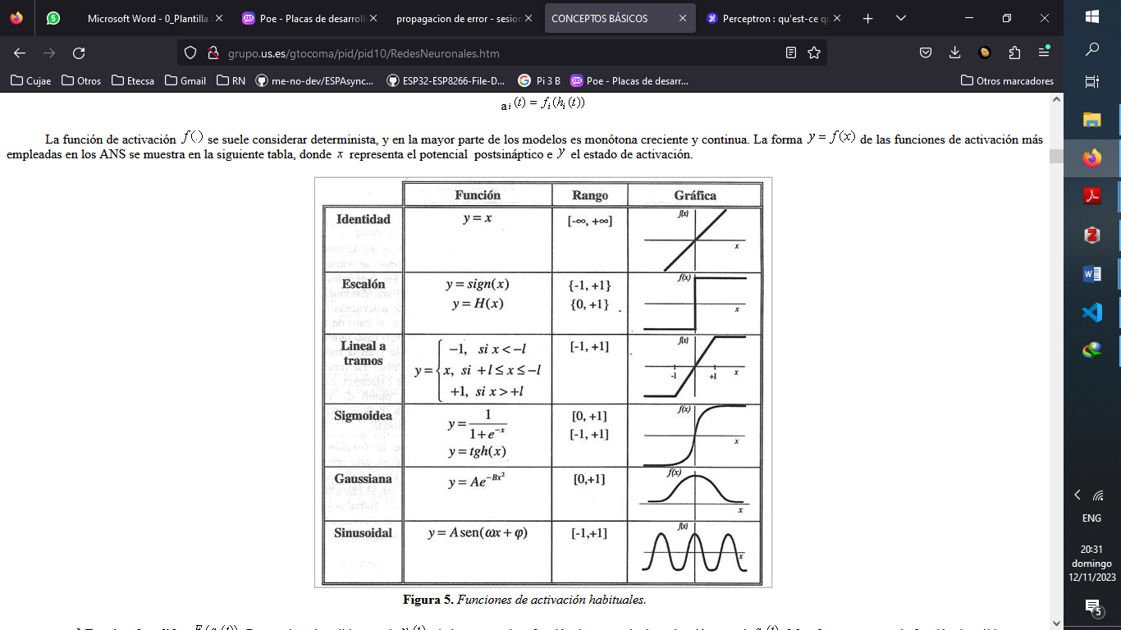
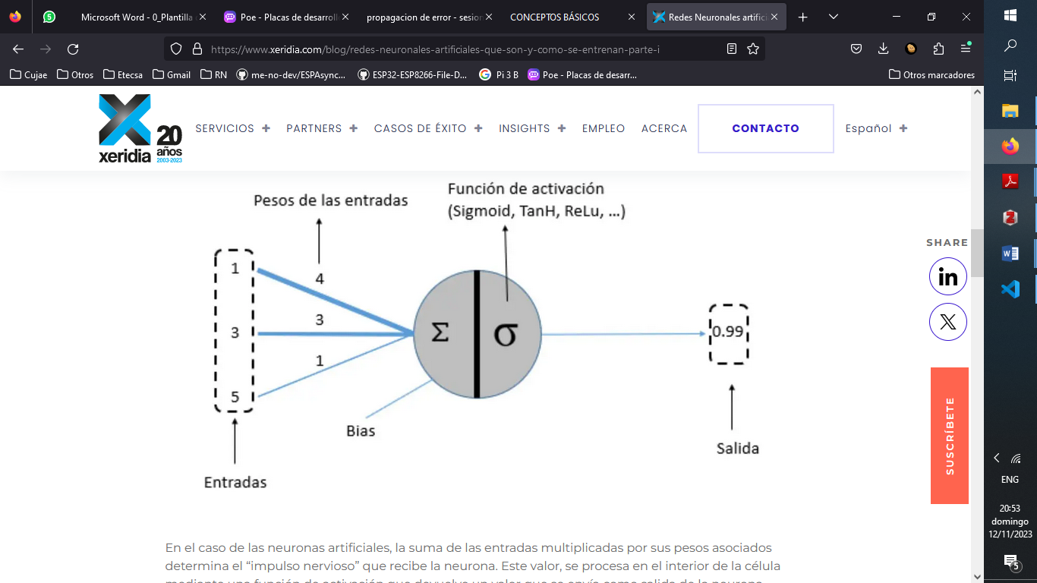
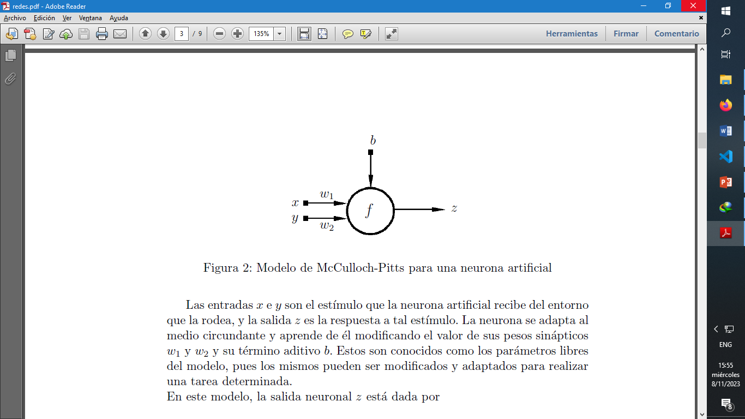
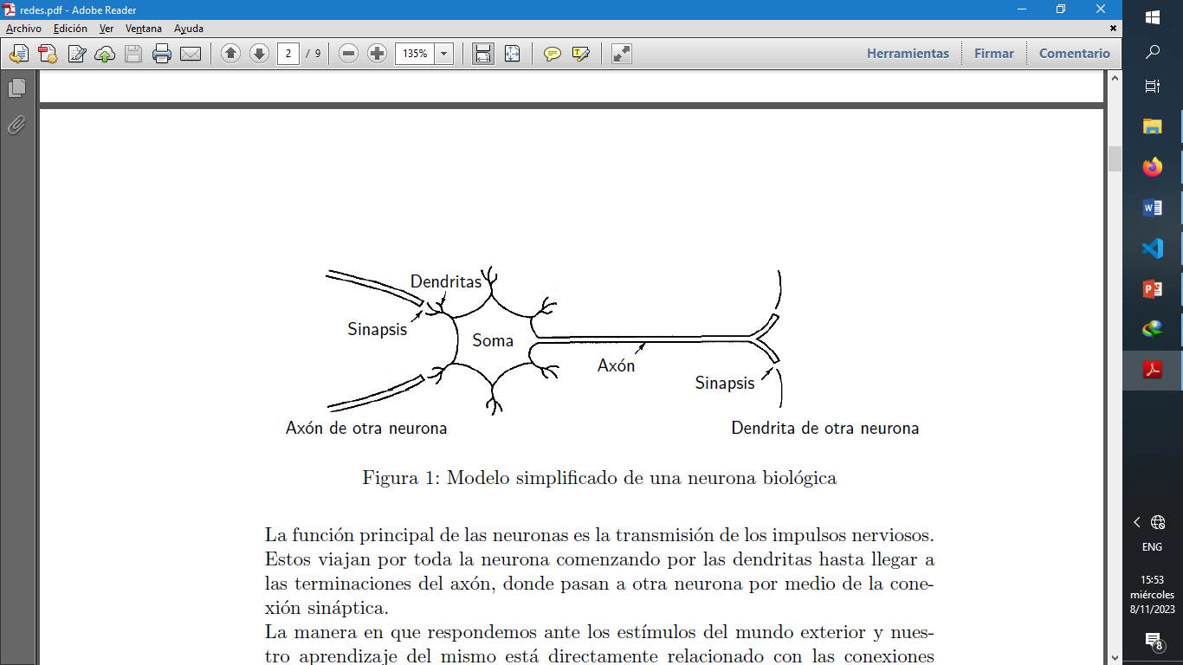

Slide 19
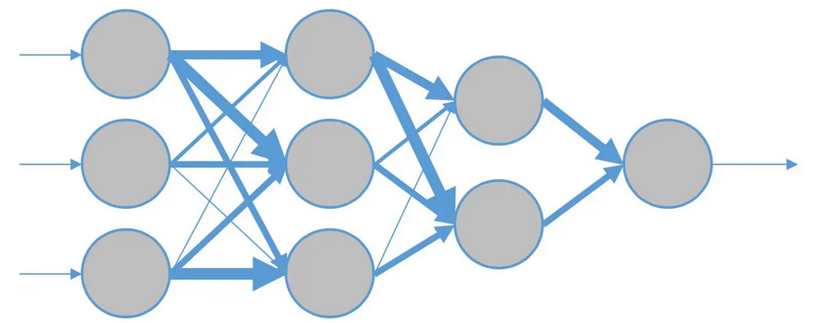
Entradas
Salida

Slide 20
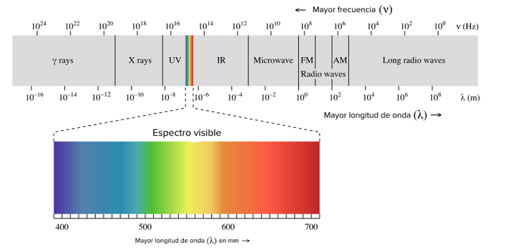

Slide 21
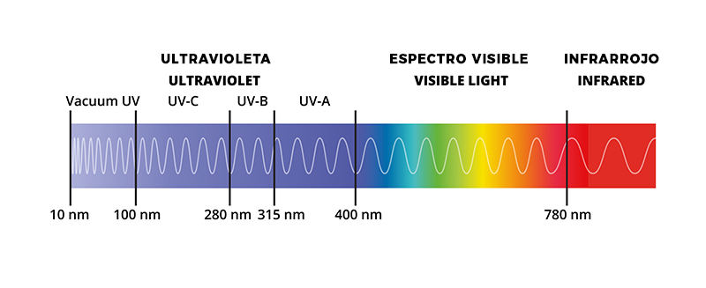
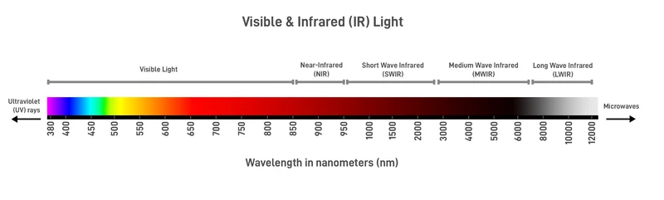

Slide 22

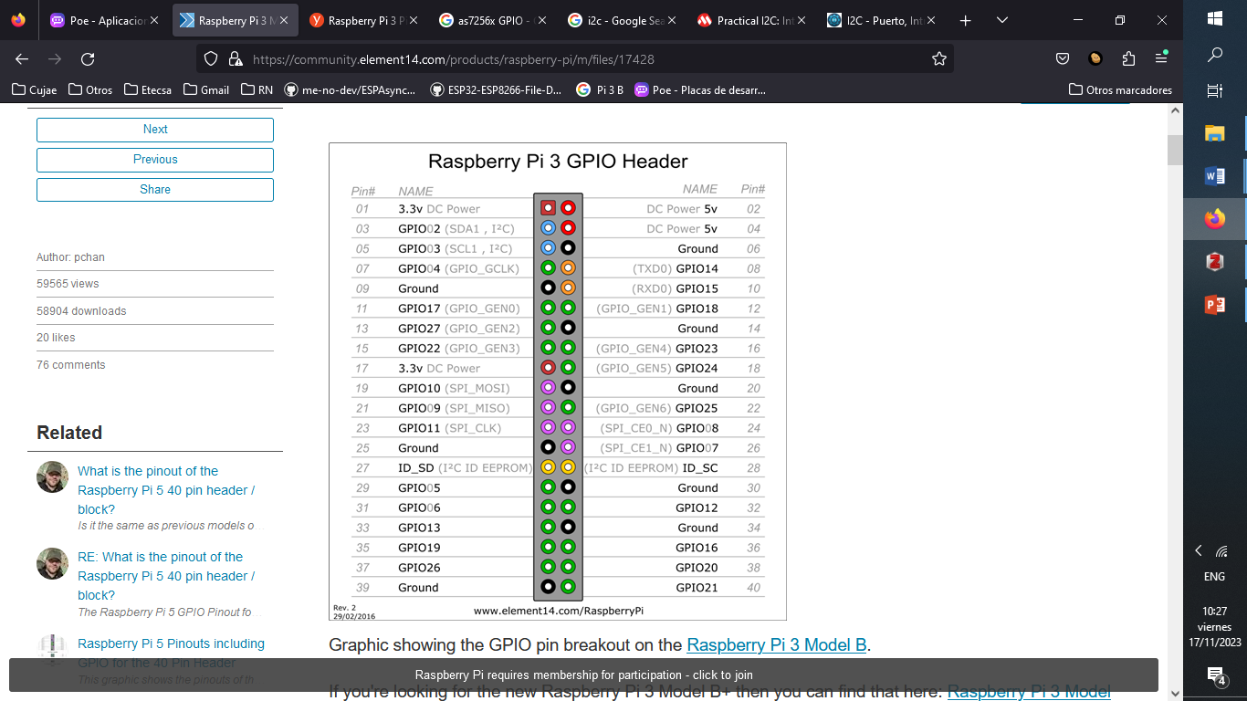
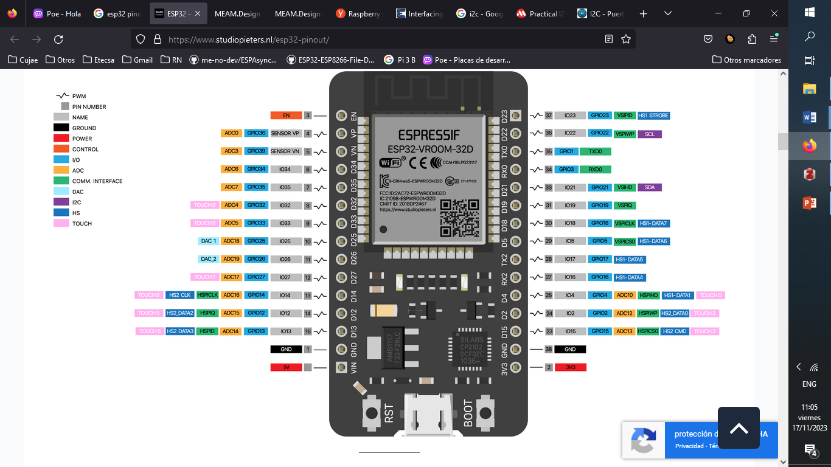

Slide 23

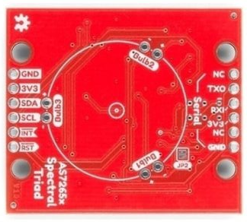
1
3
5
8

Slide 24
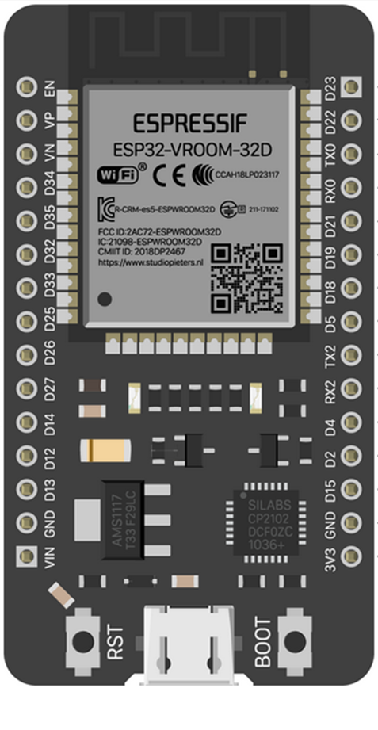

Slide 25
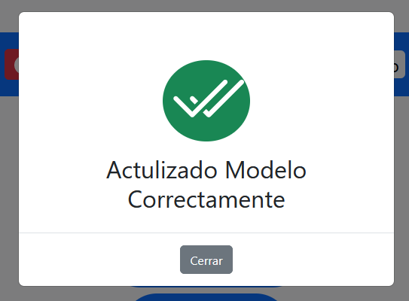
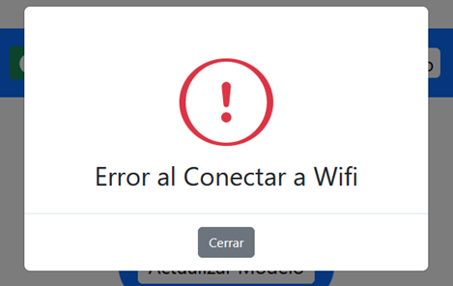

Slide 26
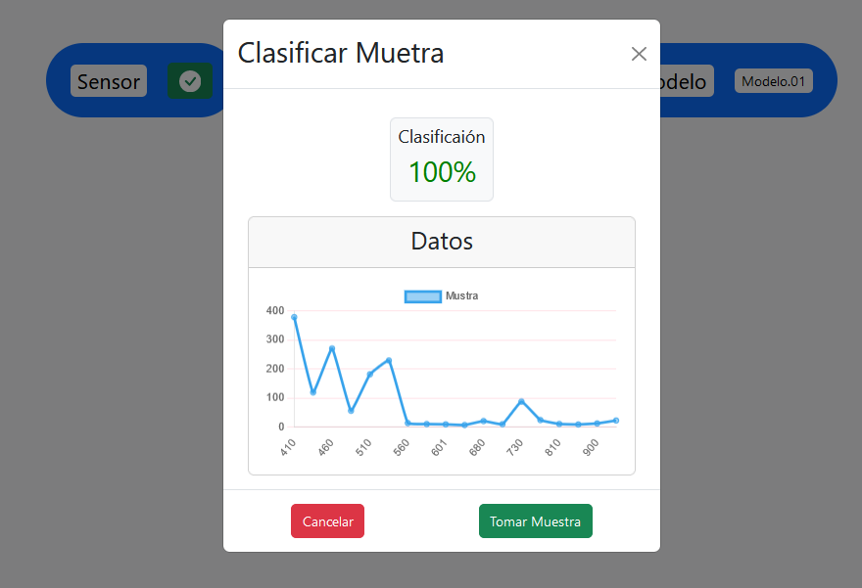

Slide 27
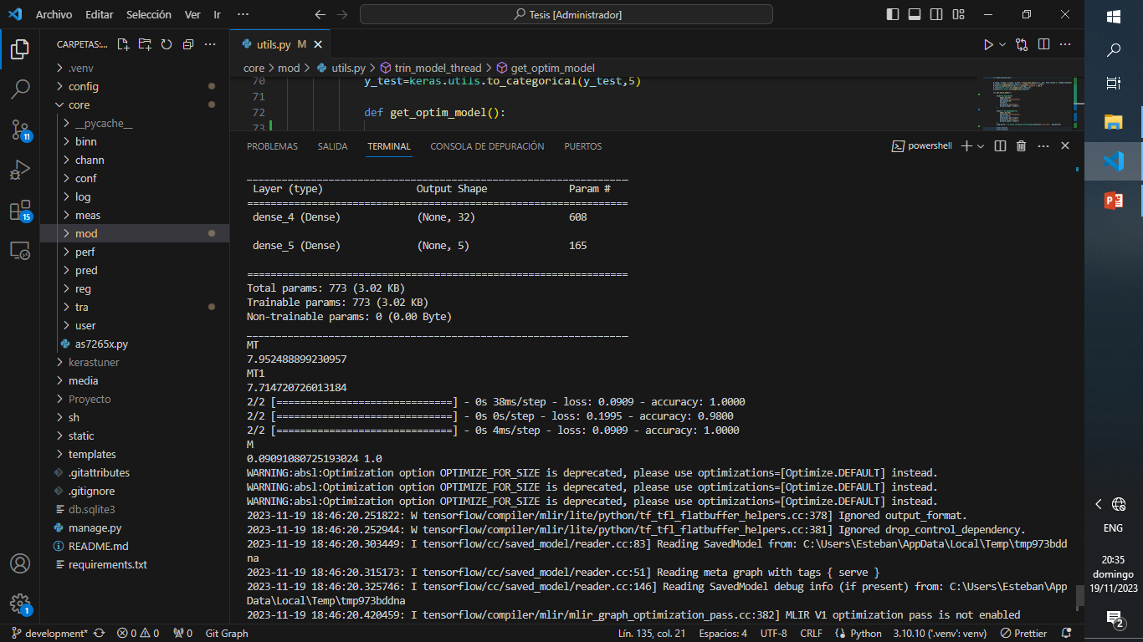
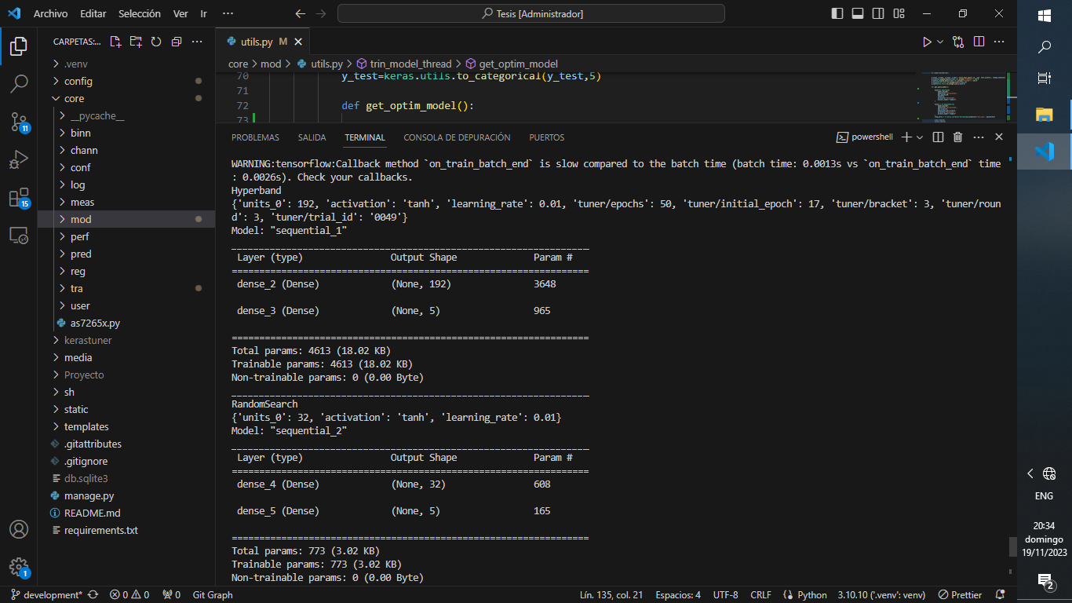
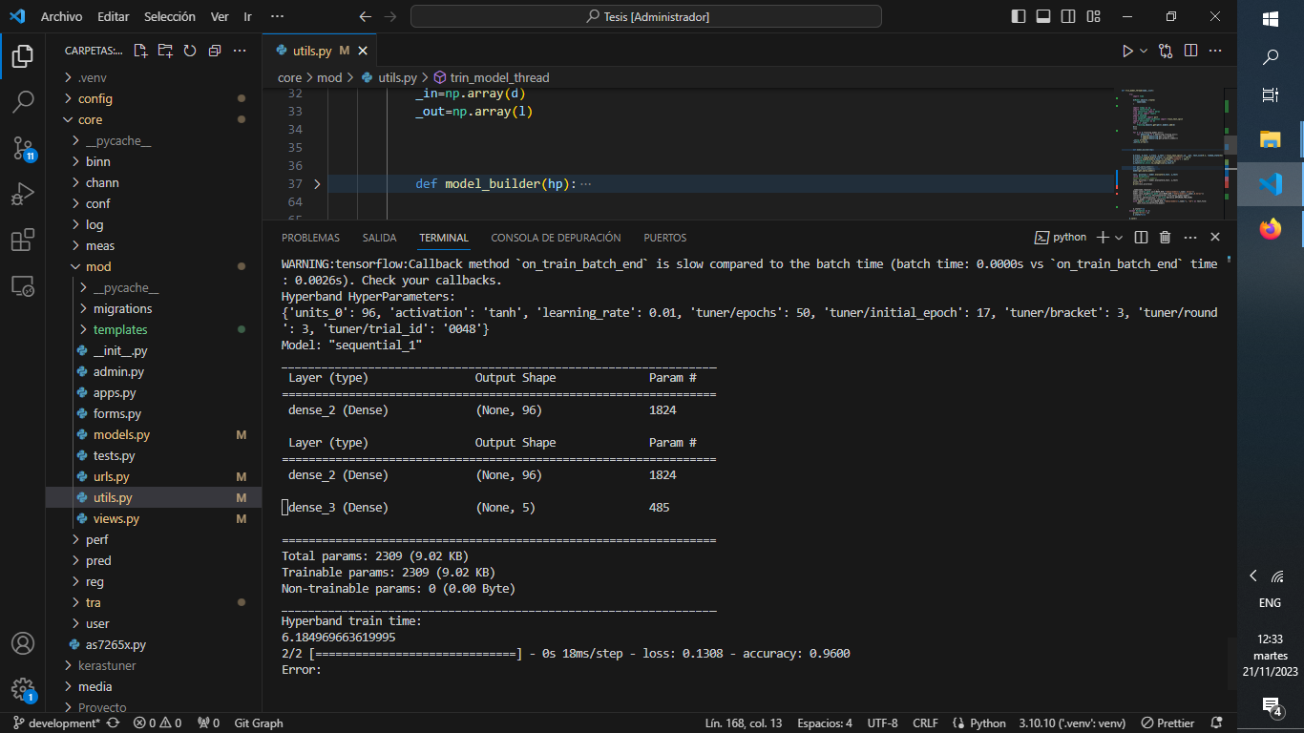

Slide 28
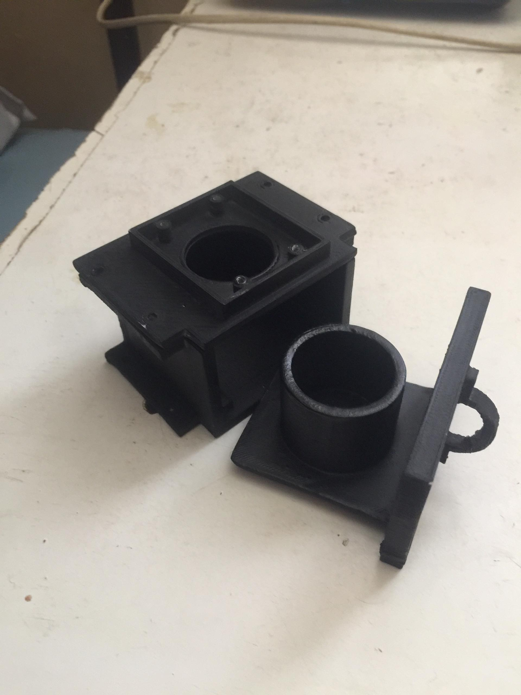
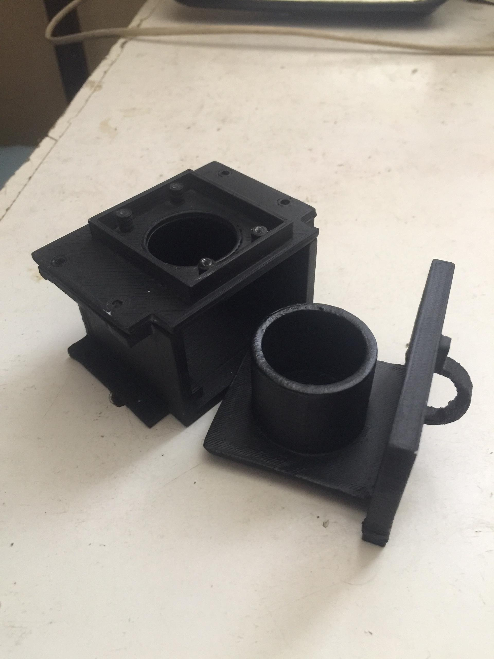

Slide 29
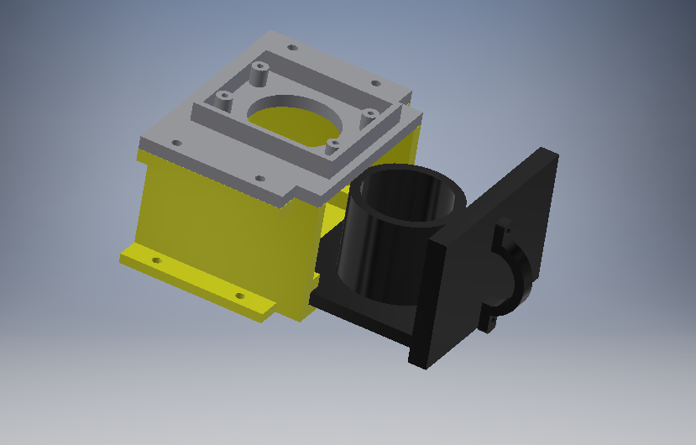

Slide 30
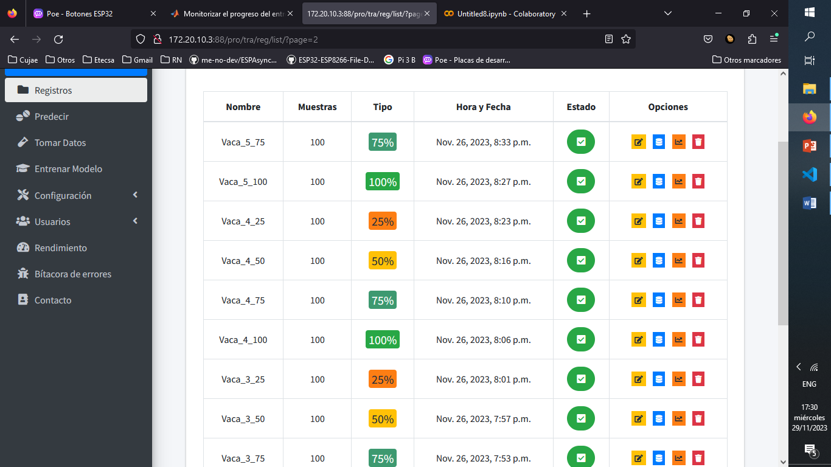
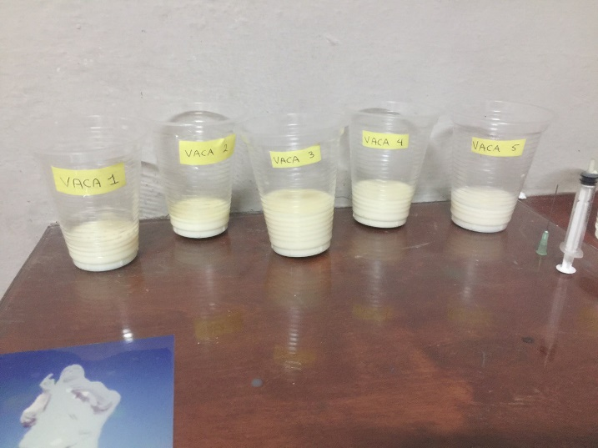

Slide 31
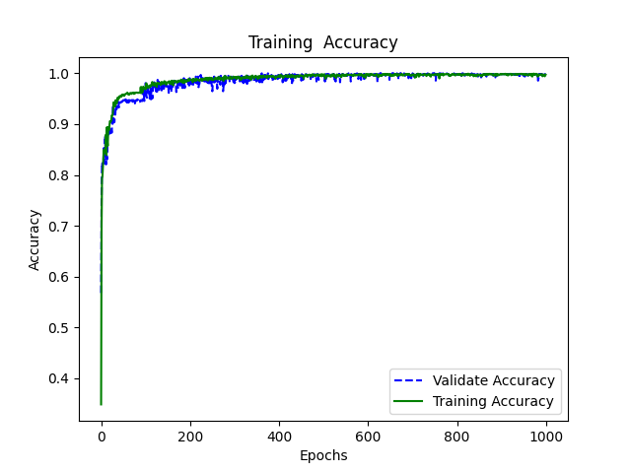
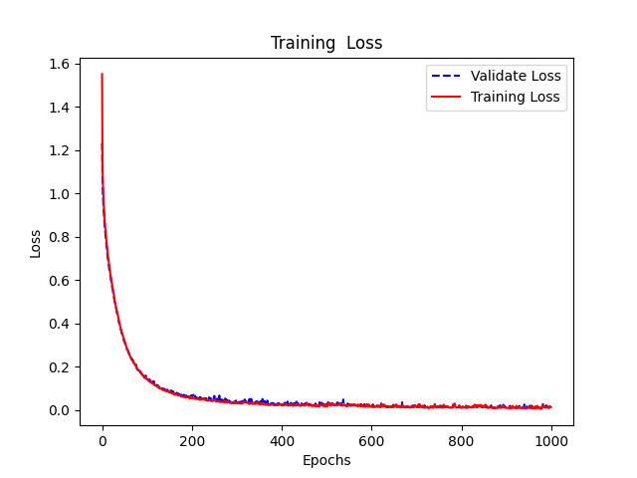
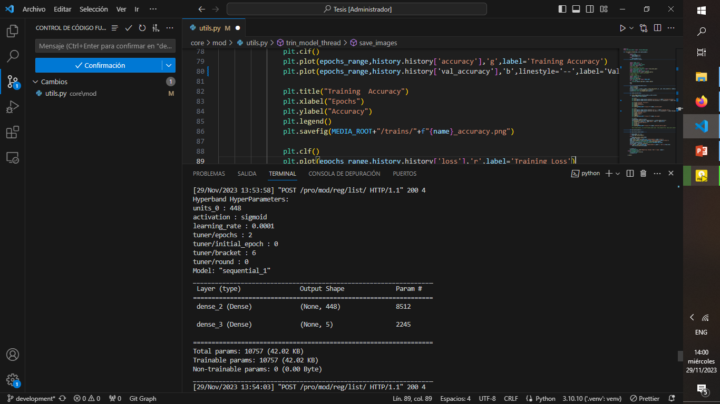
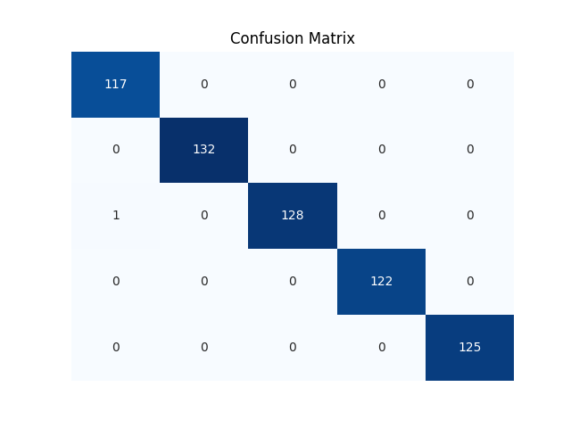
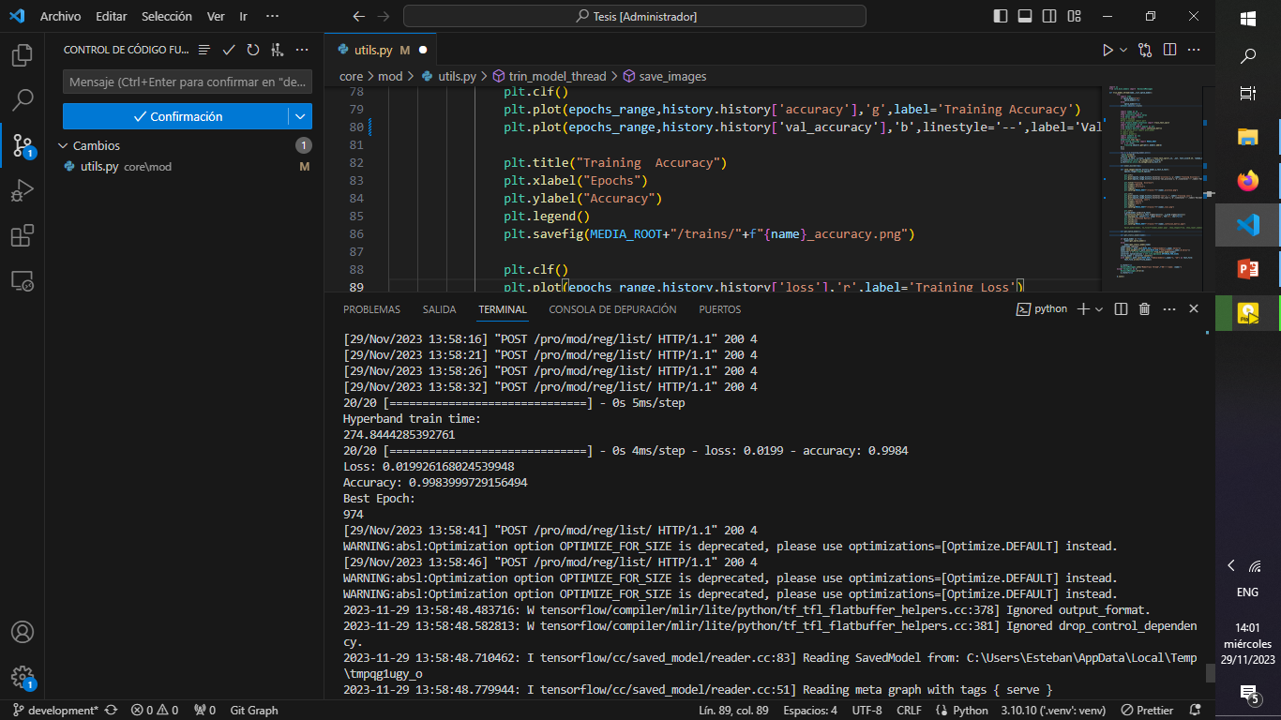

Slide 32

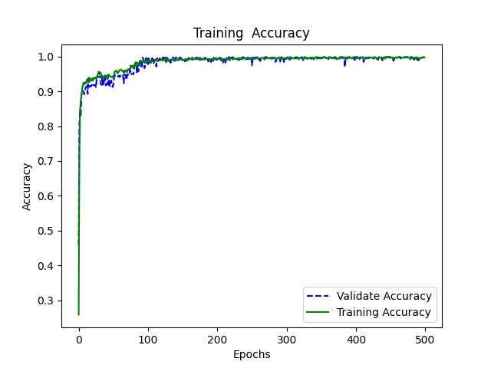
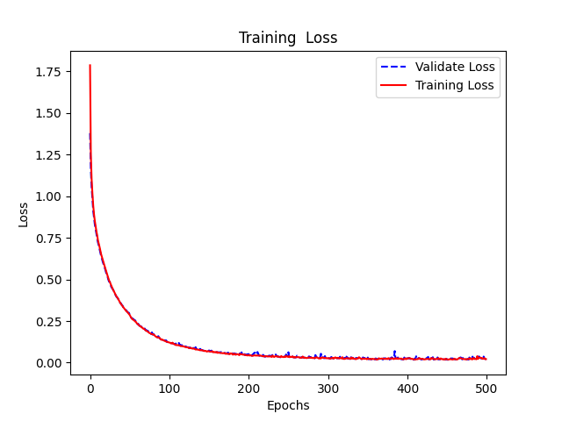

Slide 33
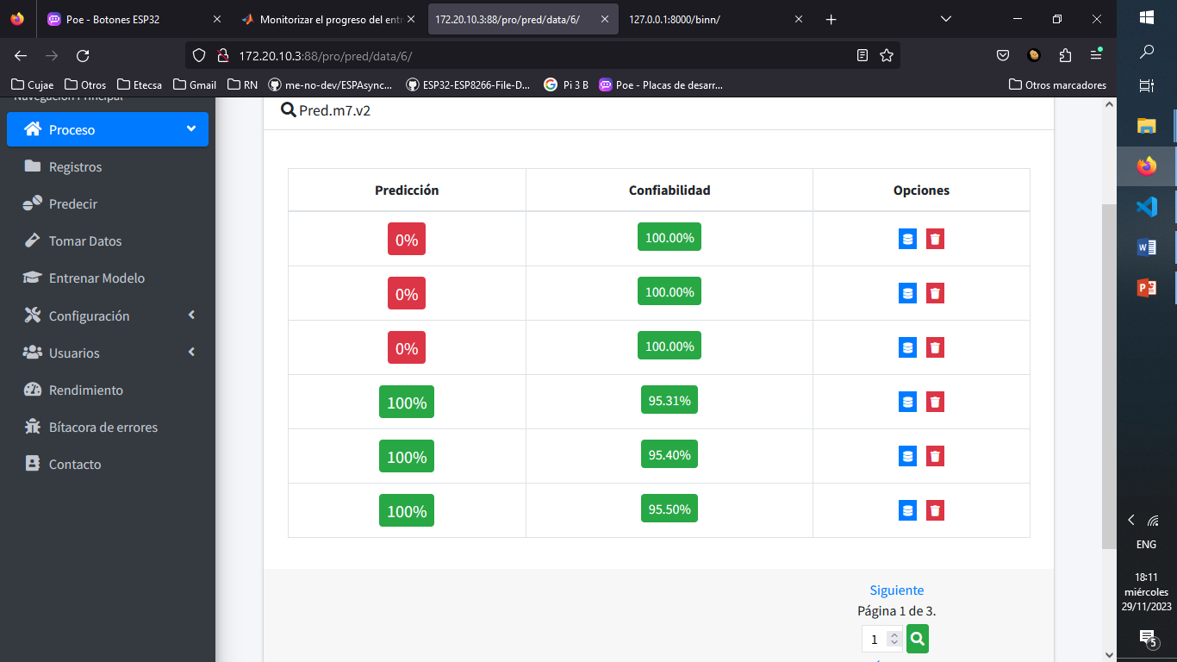
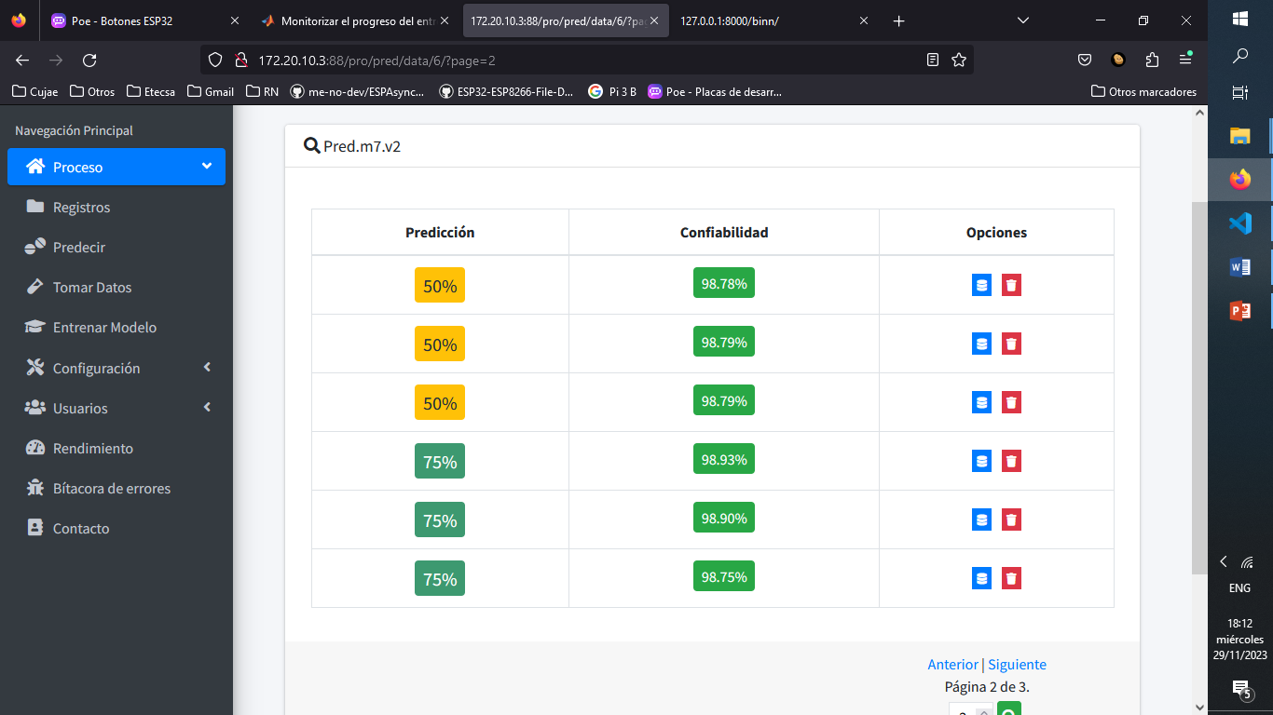
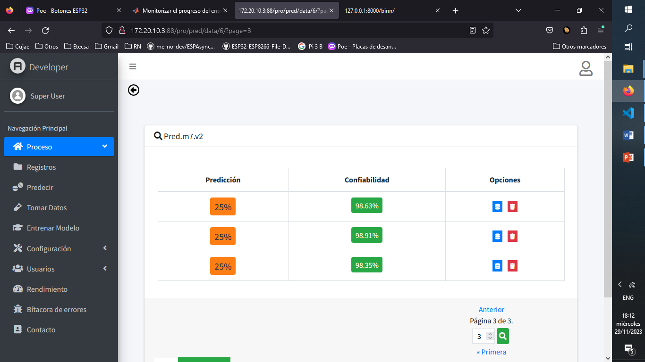

Slide 34
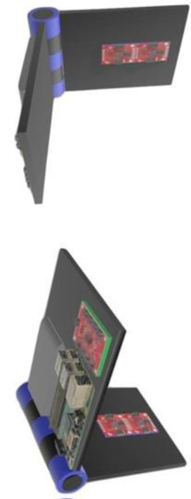

Slide 35






Dispositivos de computación de placa única
BeagleBone Black Rev C
Raspberry Pi 3 Model B
ODROID-N2
Dispositivos microcontroladores
Arduino Mega 2560 Rev3
Esp-WROMM-32
Particle Photon

Slide 36

Placas de desarrollo

Slide 37






